Slide 1
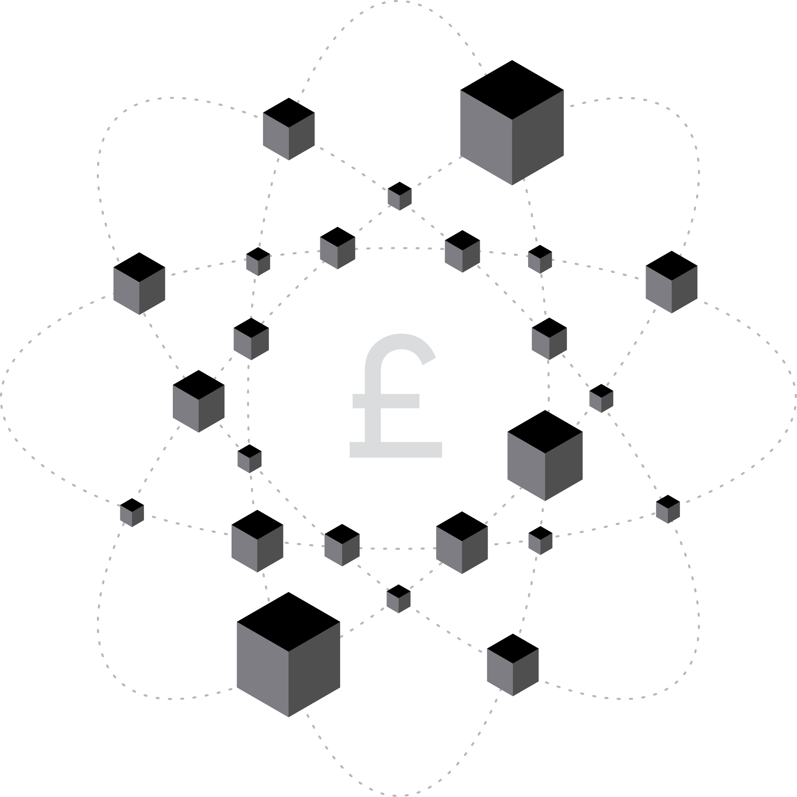
DAOs or CEOs?
Research - A Critical Analysis into DAO Governance Within the Ethereum Blockchain.
Development - DAO-B

Slide 2
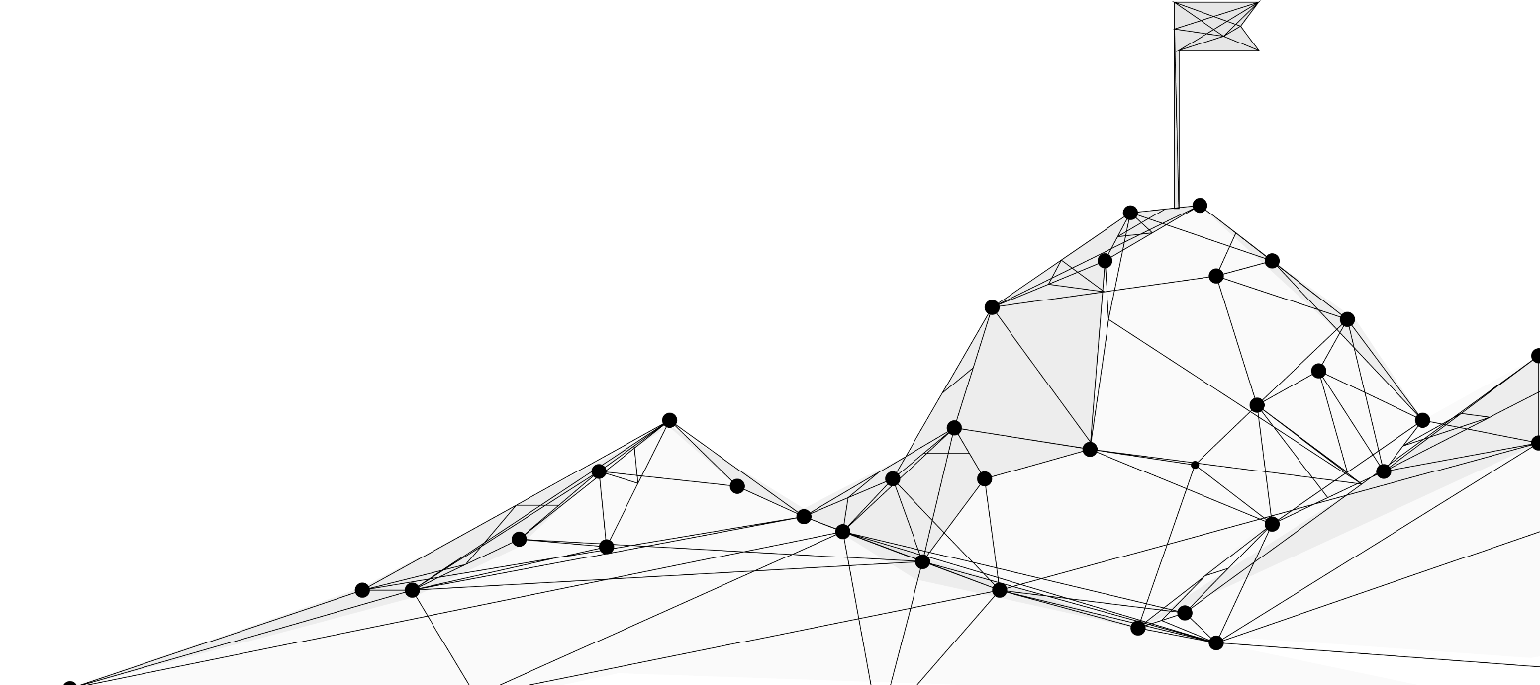
Motivations
Are DAOs really a revolutionary force for the business community?
I am a computer scientist, SaaS start-ups are a gateway for software engineers to establish low overhead high-profit businesses, of which I am interested.
It is a really new and exciting industry, with huge potential for the future with the right iterations.
Discovering whether DAO like methods be utilized in a start-up setting.

Slide 3
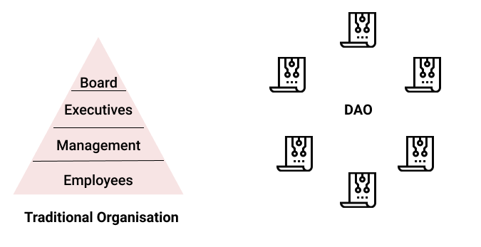
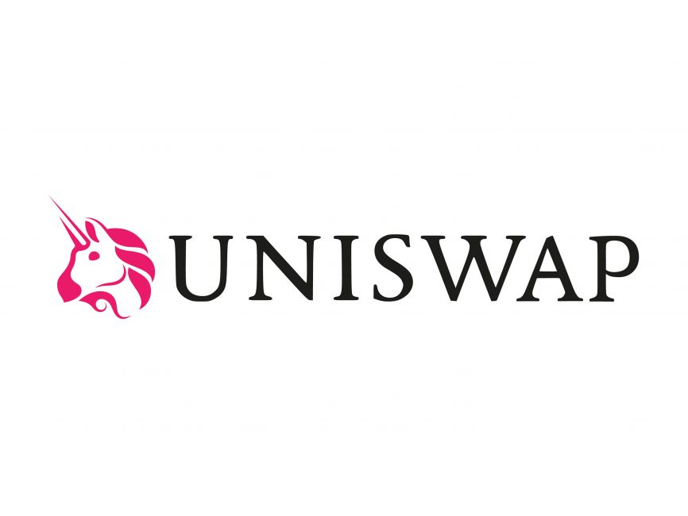
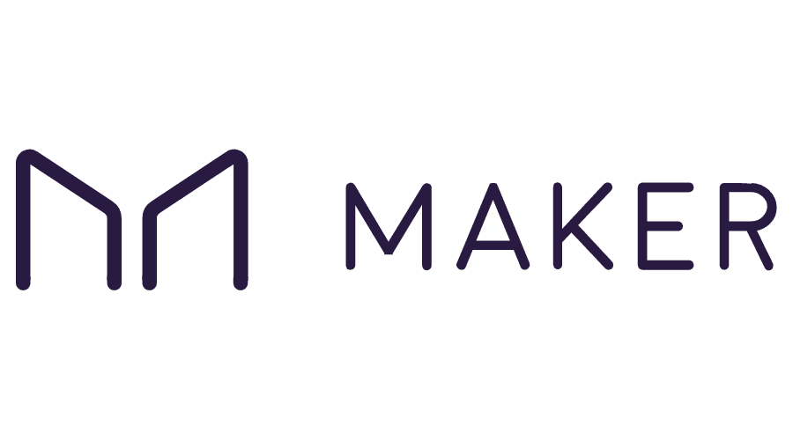
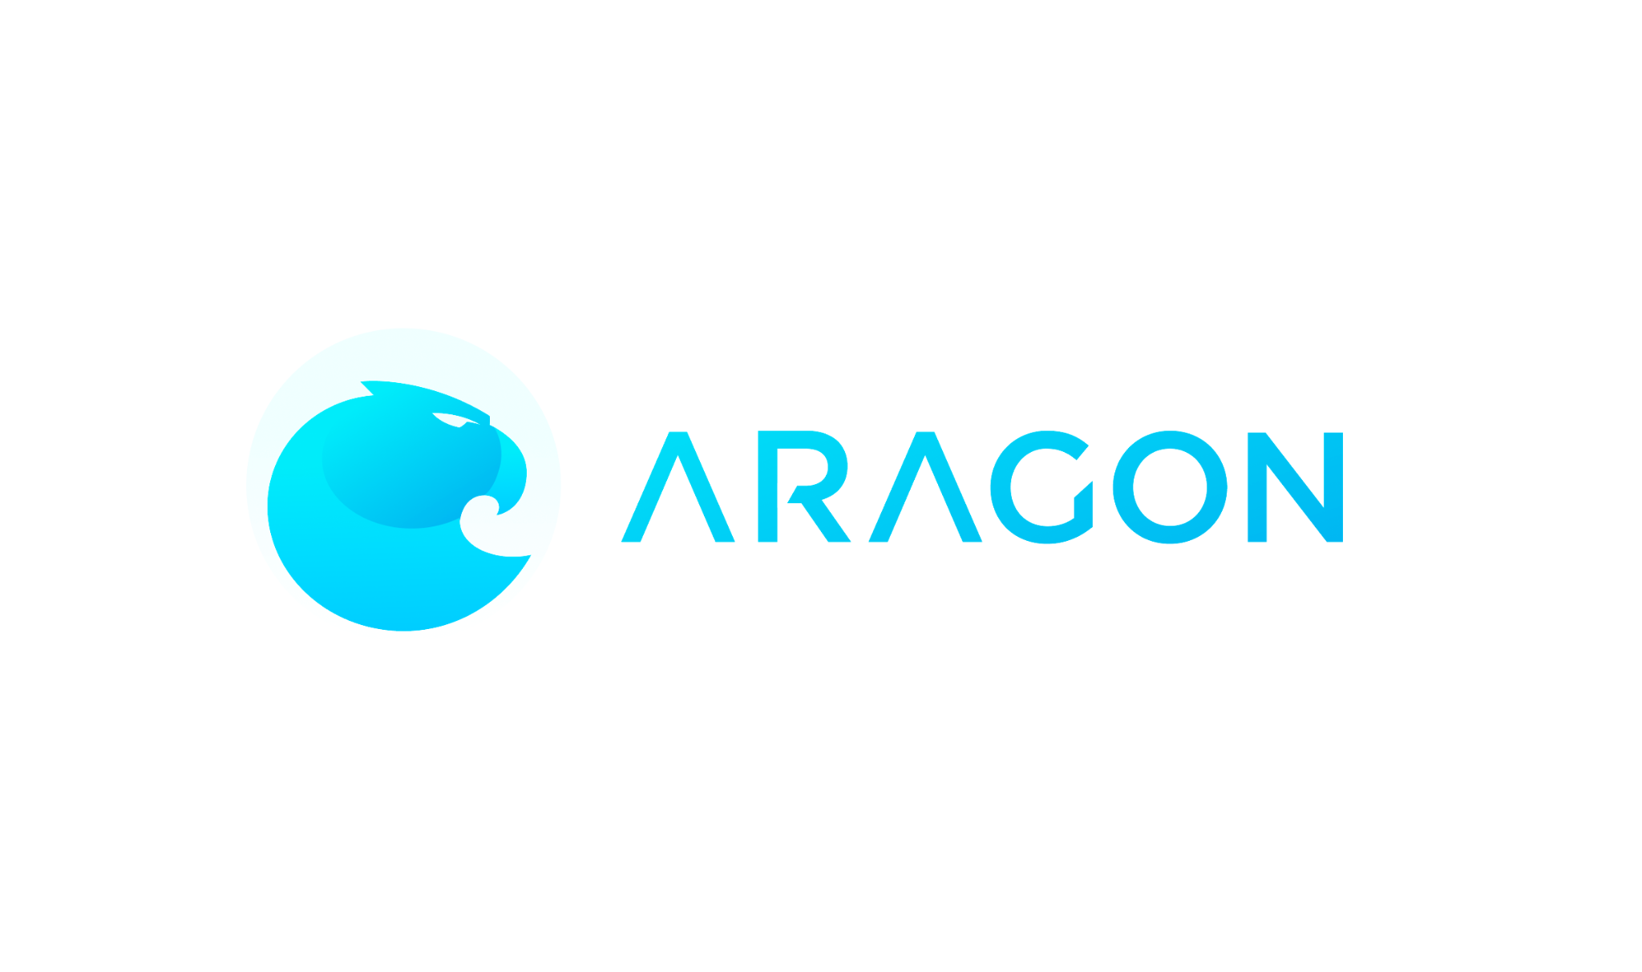
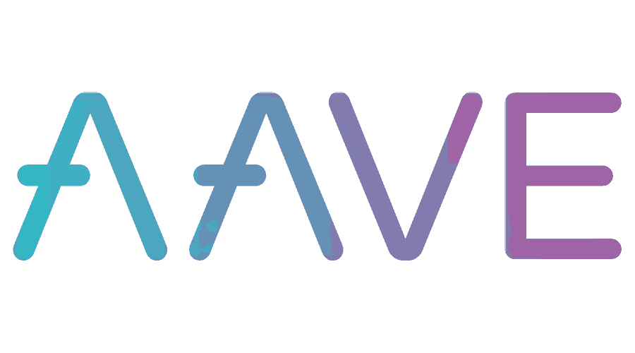
What is a DAO?
Decentralised - There is no central leadership, decisions are made from the ground up by its members.
Autonomous - The organisation takes on a life of its own, the rules put into place allow for a host of business proceedings to be fully automated
Organisation - It follows its own set of internalised rules with its own separate fund management, separate of banks.
Advantages
- Fundraising
- Transparency
- Equality
- Trust
Disadvantages
- Slow decision making
- Low voter participation
- Internal Politics
- Wrong direction
There are already over 180 DAOs (tracked by deepdao.io) with $10B+ in assets under management and nearly 2 million members.

Slide 4
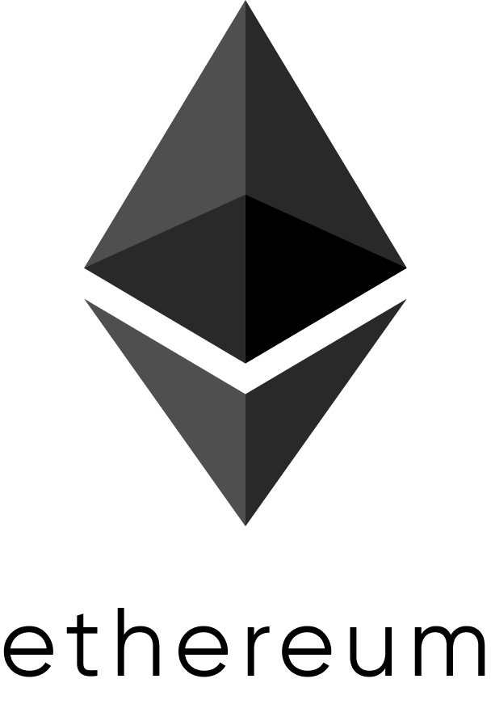
Ethereum
Ethereum is a platform powered by blockchain technology that is best known for its native cryptocurrency, called ether, or ETH, or simply ethereum. The distributed nature of blockchain technology is what makes the Ethereum platform secure, and that security enables ETH to accrue value.
The Ethereum platform supports ether in addition to a network of dApps. Smart contracts, which originated on the Ethereum platform, are a central component of how the platform operates. Many DEFI and other applications use smart contracts in conjunction with blockchain technology.
Cons
Sluggish transaction speed
High gas fees
First-mover disadvantage
Scalability issues
Pros
Decentralised nodes and governance
Large community
Fast Deployment of smart contracts
Network reliability

Slide 5

On-Chain or Off-Chain? Or, both?
Being on-chain presents a variety of pros and cons in the business use case.
Pros
security, community, accessibility, transparency.
Cons
slow, costly, restrictive, inhibiting.

Slide 6

Decentralised
Autonomous
Organisation
Bonuses
By Cameron Calder

Slide 7
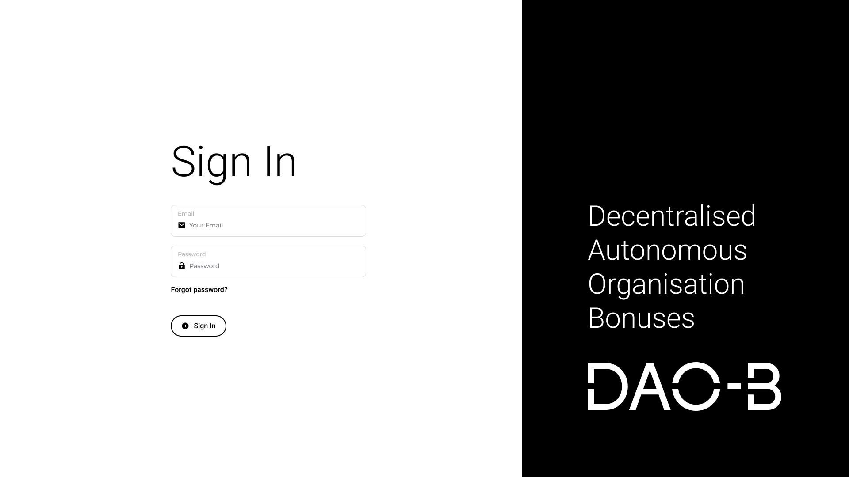

Slide 8

Users

Slide 9
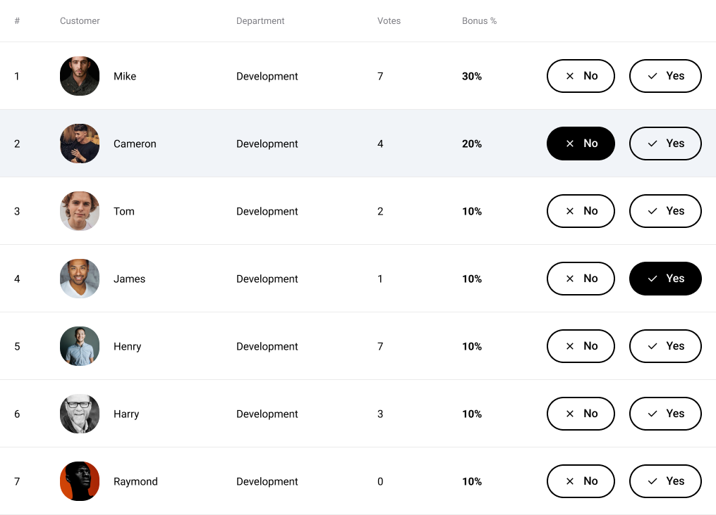
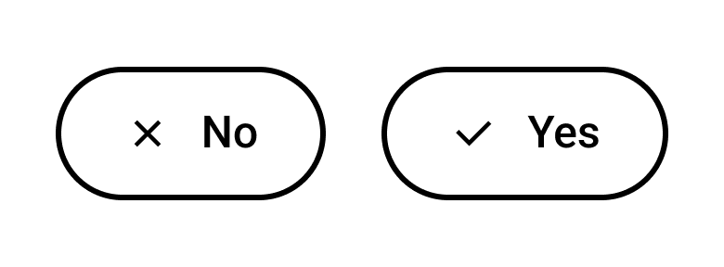
Voting Panel
Each member of the team can propose the bonus they think they deserve, this is then voted on anonymously by other members of the team.

Slide 10
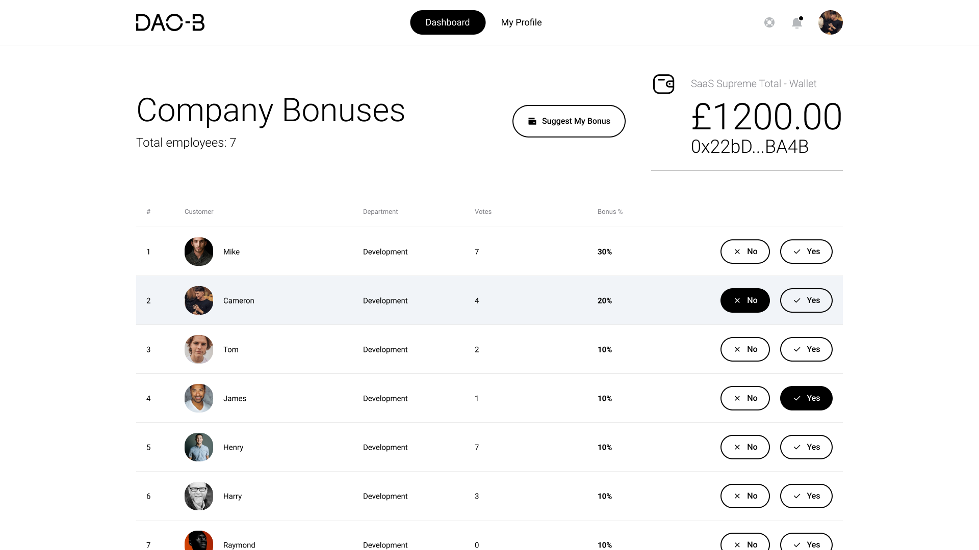

Slide 11
Each member of the team has the right to suggest the bonus they would like to apply for, I am currently set on a % based system but I may opt for an input amount instead.
Notifications & Account settings for users.
Total votes are tallied here, I have decided to keep votes anonymous so as to create a divisive environment in the team.
Employees can be added by the owner of the business. I chose to keep flexibility in the total, allowing scalability.
The total wallet amount is viewable by the team. This is distributed at the end of every vote period.

Slide 12
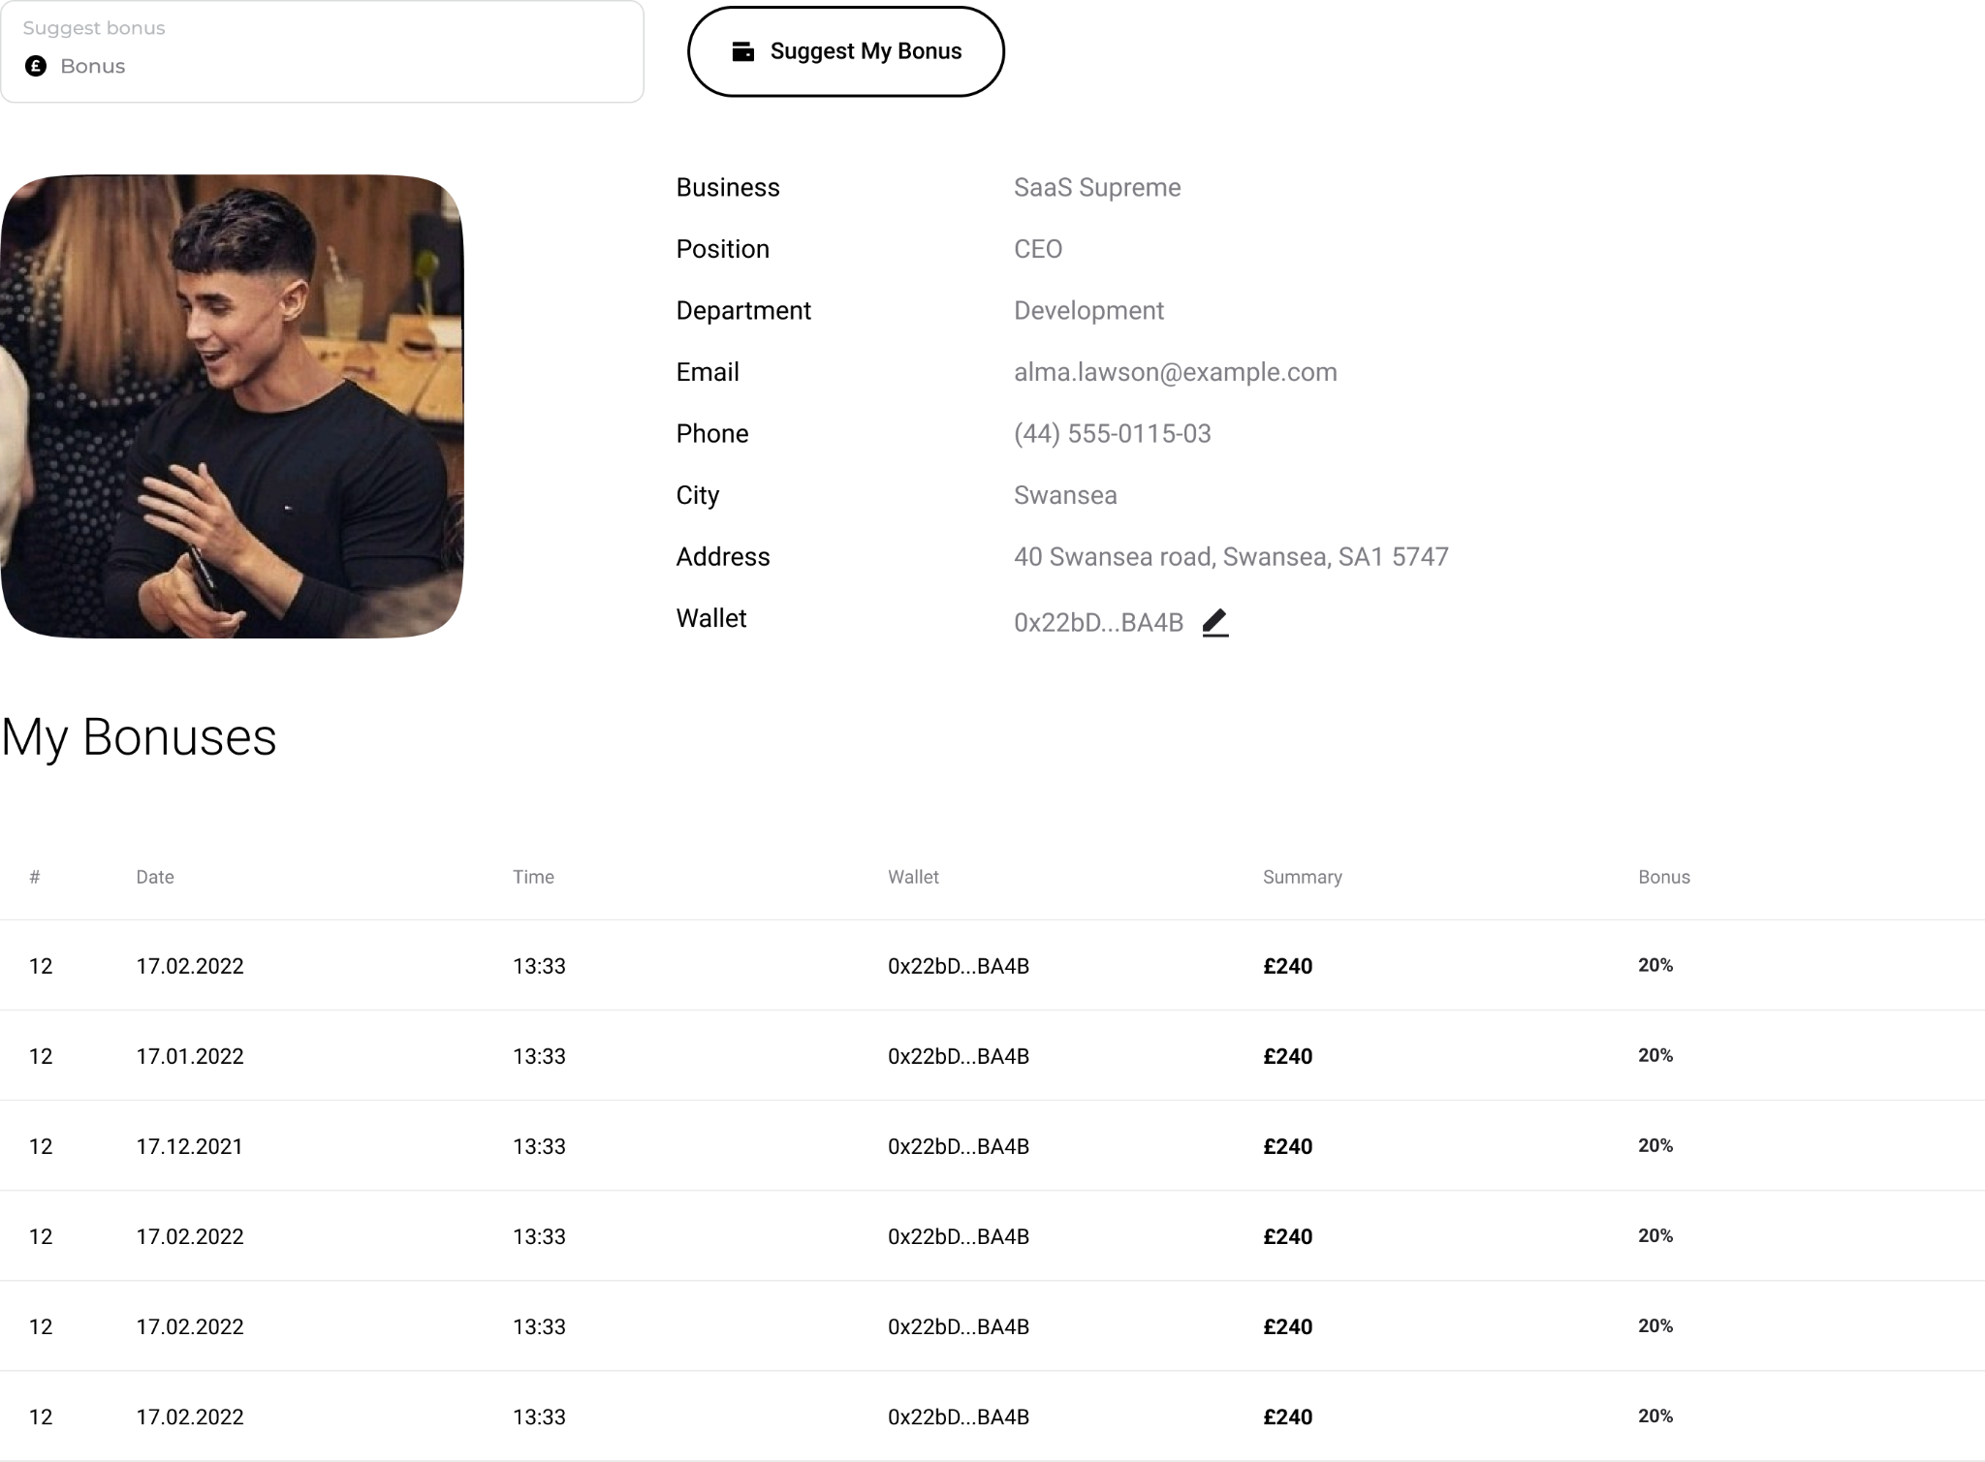
Staff Accounts
Each staff member has access to their account, verification will be handled through their wallet. The creator of the DAO-B for the business can add wallets to the system, all wallets added will become receiver wallets & have staff permissions. Each connected wallet can then input details onto the system to link their information.

Slide 13
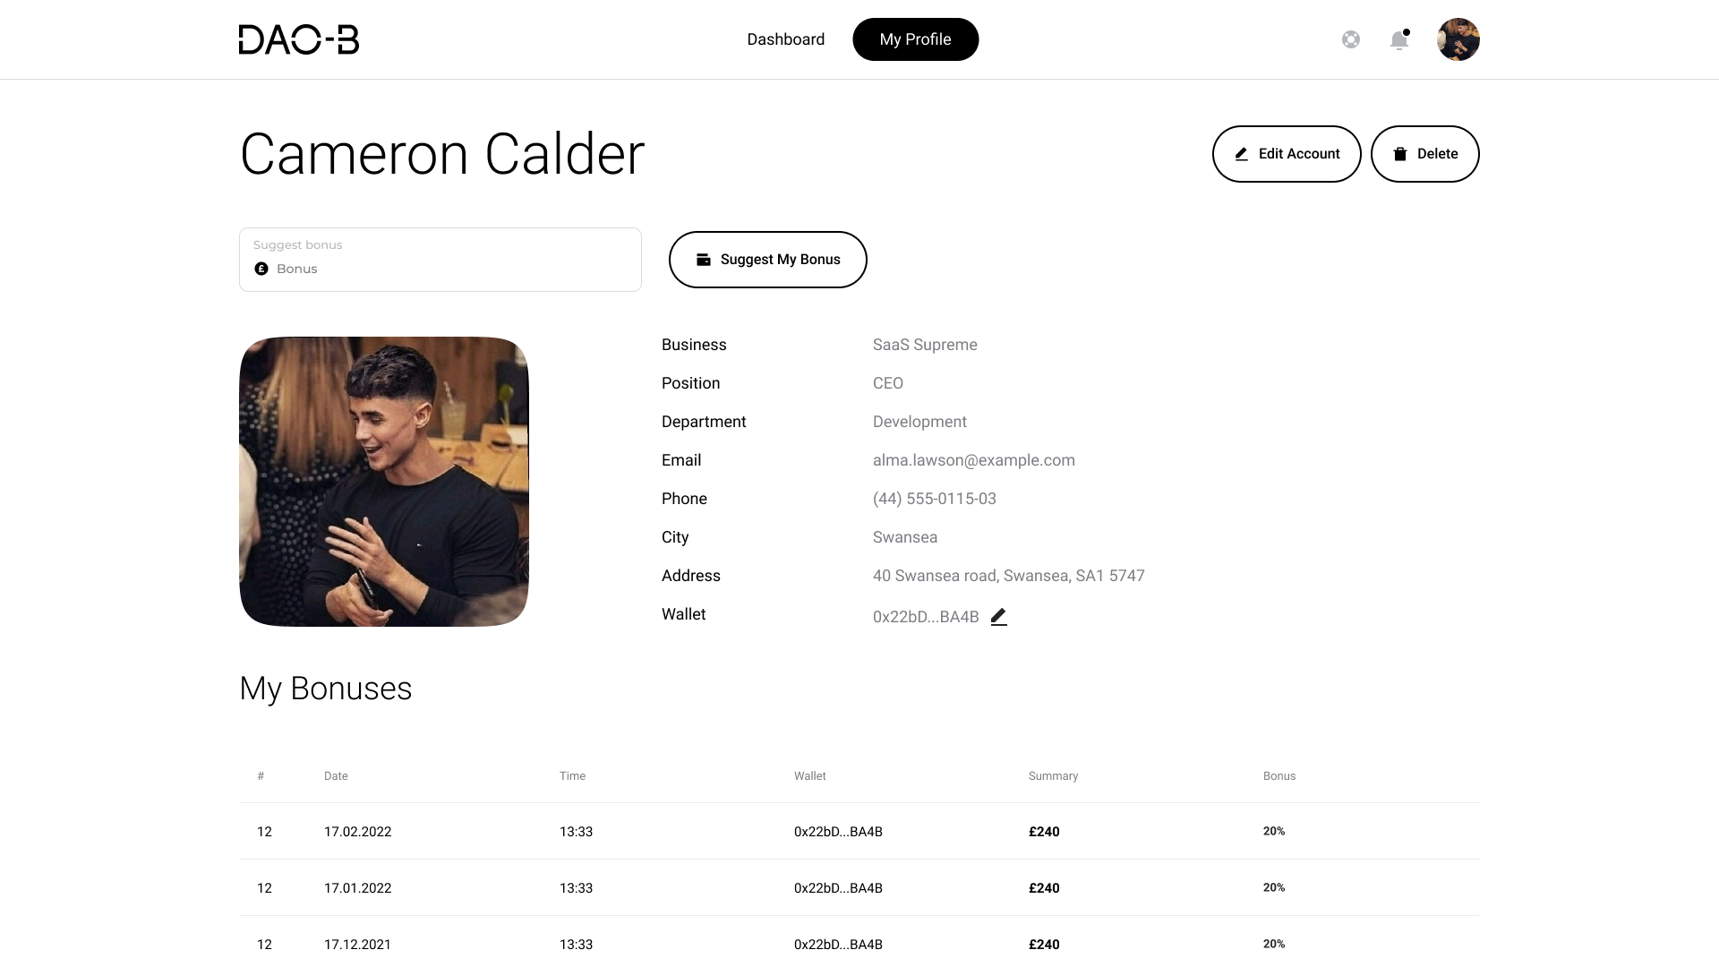

Slide 14
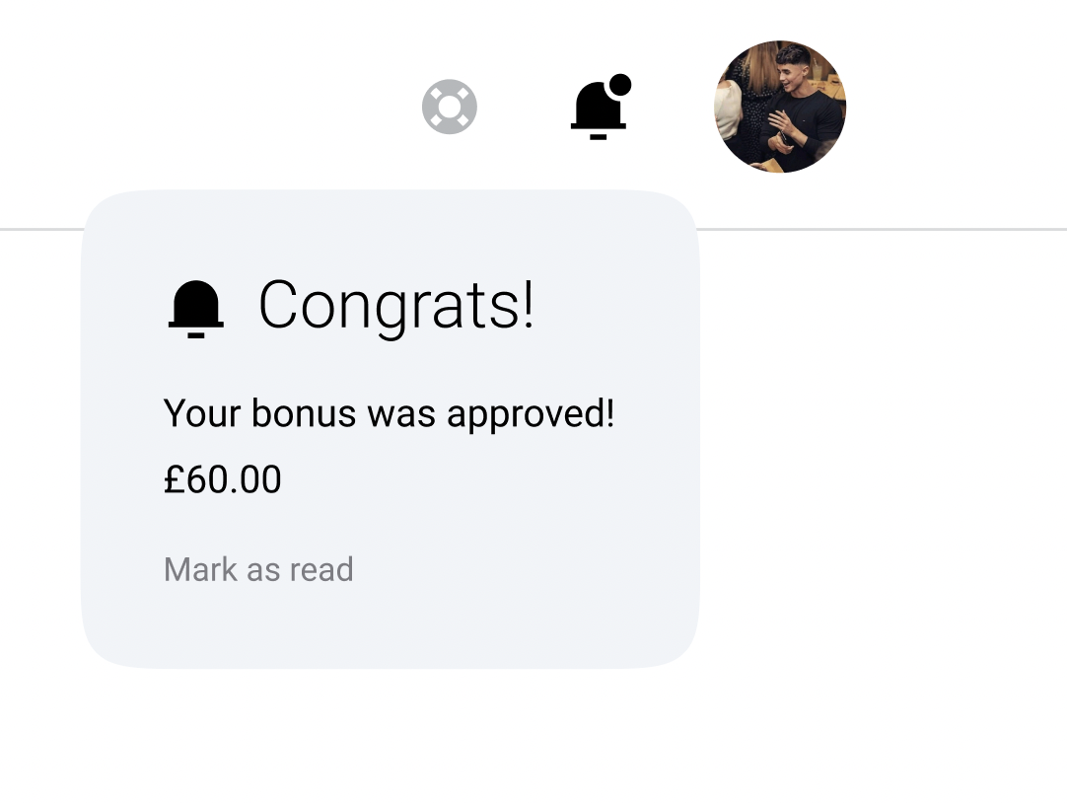
To be data compliant accounts can be managed directly by the account owner, edit & full deletion included.
Notifications for approved proposals, votes and payouts.
Suggest bonus tab here, I’ve made information input here fluid, the DAO-B system can be easily interchanged to vote on other fund management issues if a few edits are made.
Bonus history can be tracked here with the wallet address it was sent to, this information is only accessible for the user & the admin, not peers.

Slide 15
Owner - Admin

Slide 16
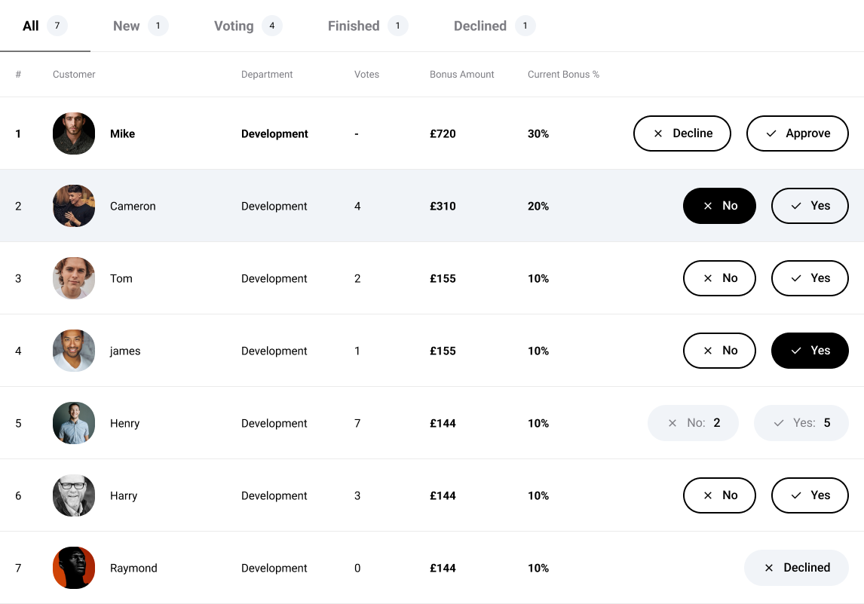
Admin Dashboard
The DAO-B admin dashboard is granted to the founder of the business who sets up the initial system and has the credentials for the main wallet. Here the admin can approve bonus proposals, vote in approved proposals and see the count of votes. The votes are still however, anonymous.

Slide 17
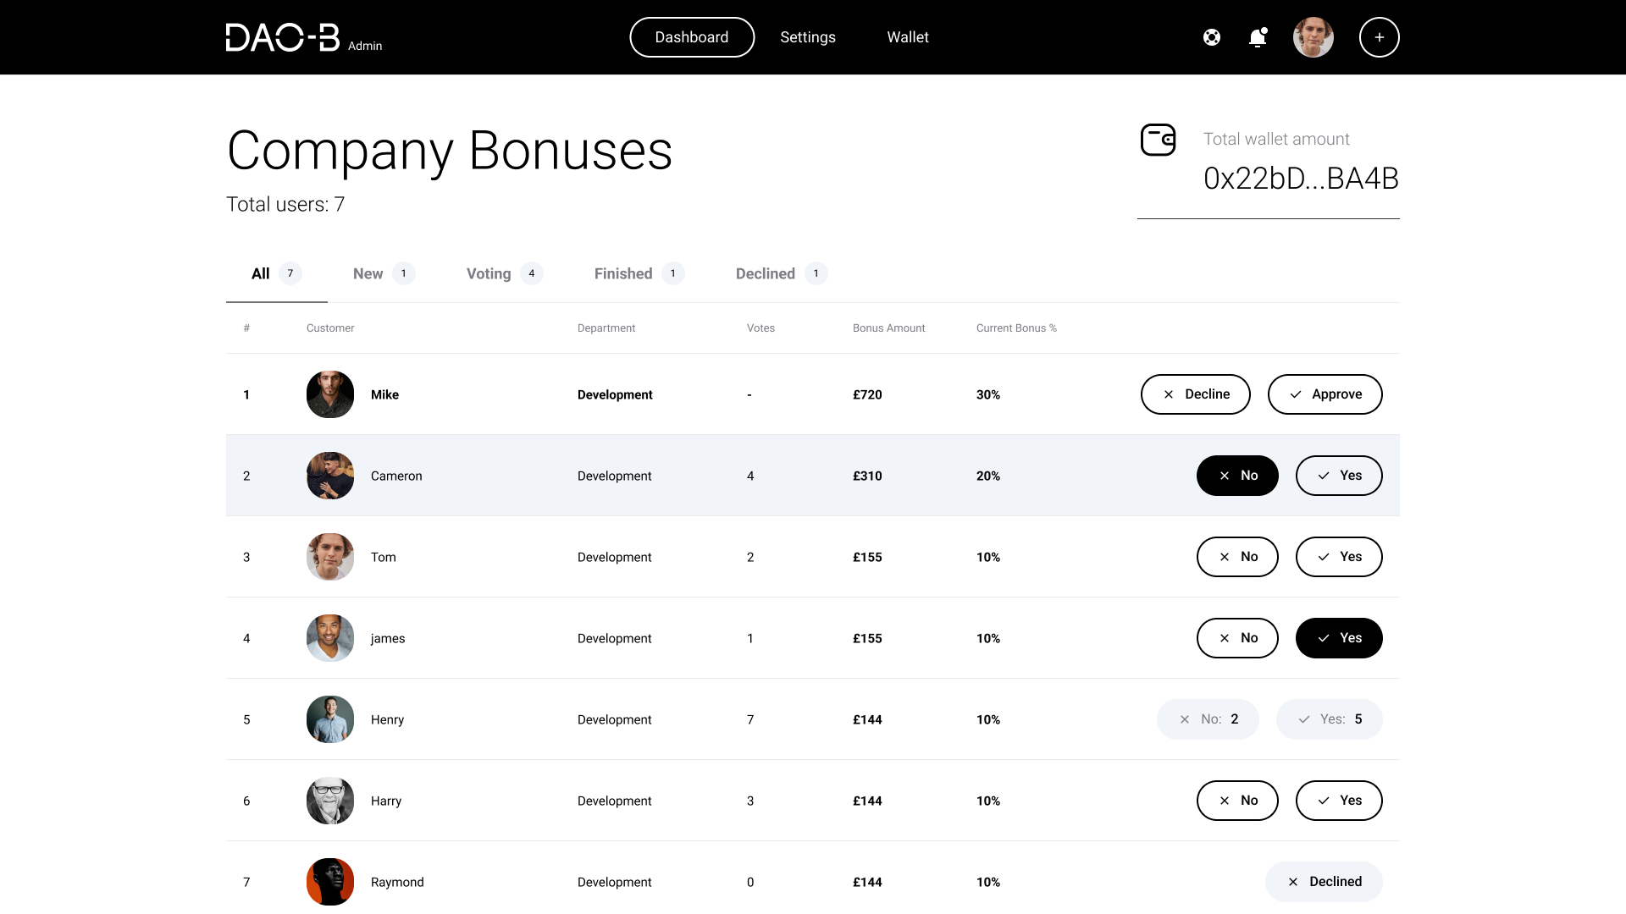

Slide 18
Admins also have wallet controls built in.
Filter for different stages of proposals.
Admins see proposals before they go to votes, they can either be approved or denied here.
Admins have equal voting rights to other members of the organisation, once a proposal goes to votes it cannot be changed. Admins can also see the count.

Slide 19
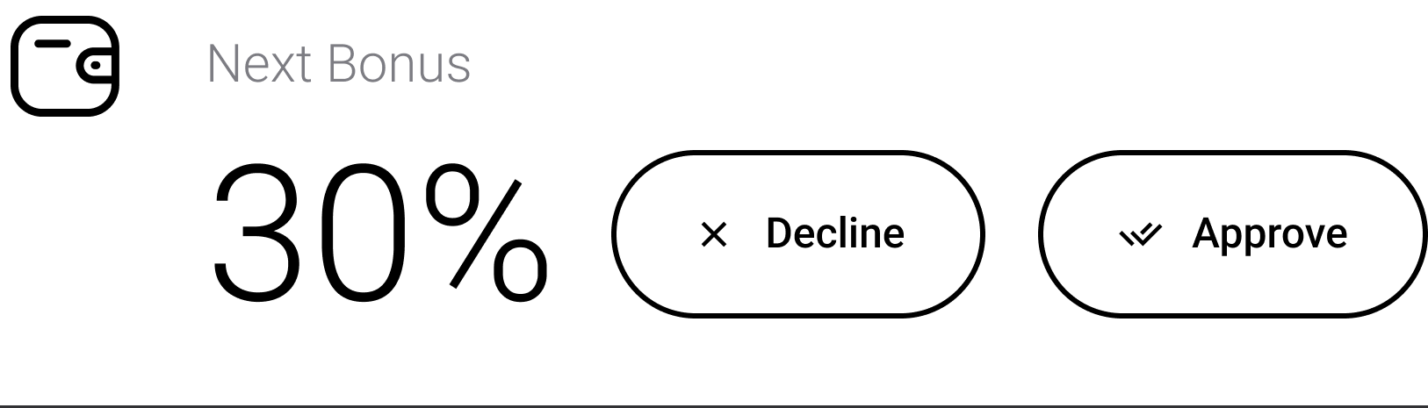
Admin Approval
A slightly less decentralised aspect of the business is the approval I have worked into the system. Once the proposal has been approved it then goes to vote, once it has been approved it cannot be changed and the smart contracts maintain the pay-out. I believe this is needed in business as relying on the sensibility and credibility of human nature not to hijack the system is not feasible for businesses.

Slide 20
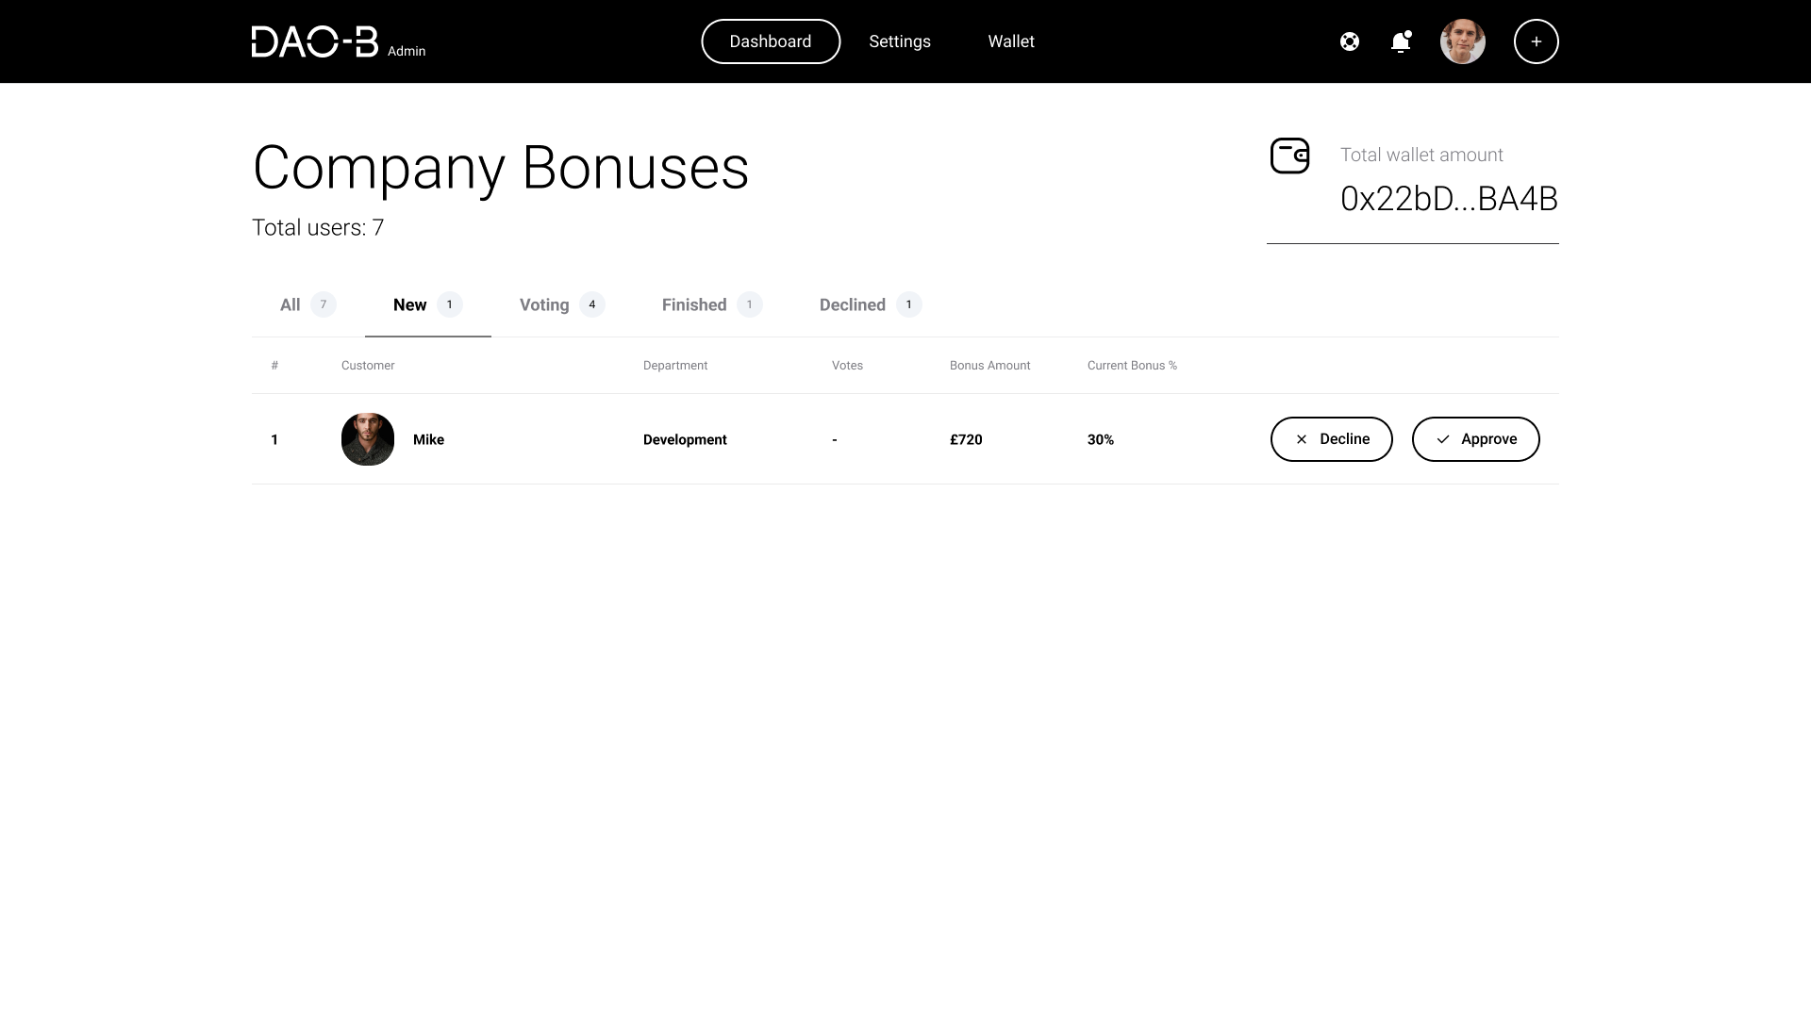

Slide 21
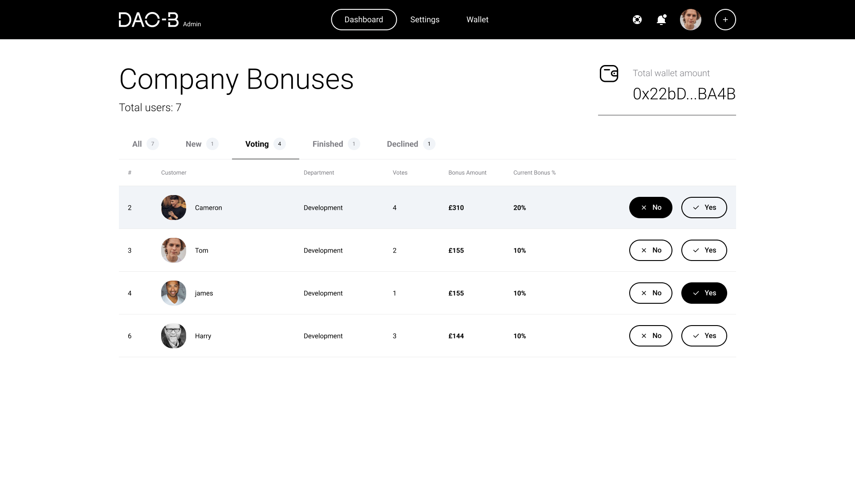

Slide 22
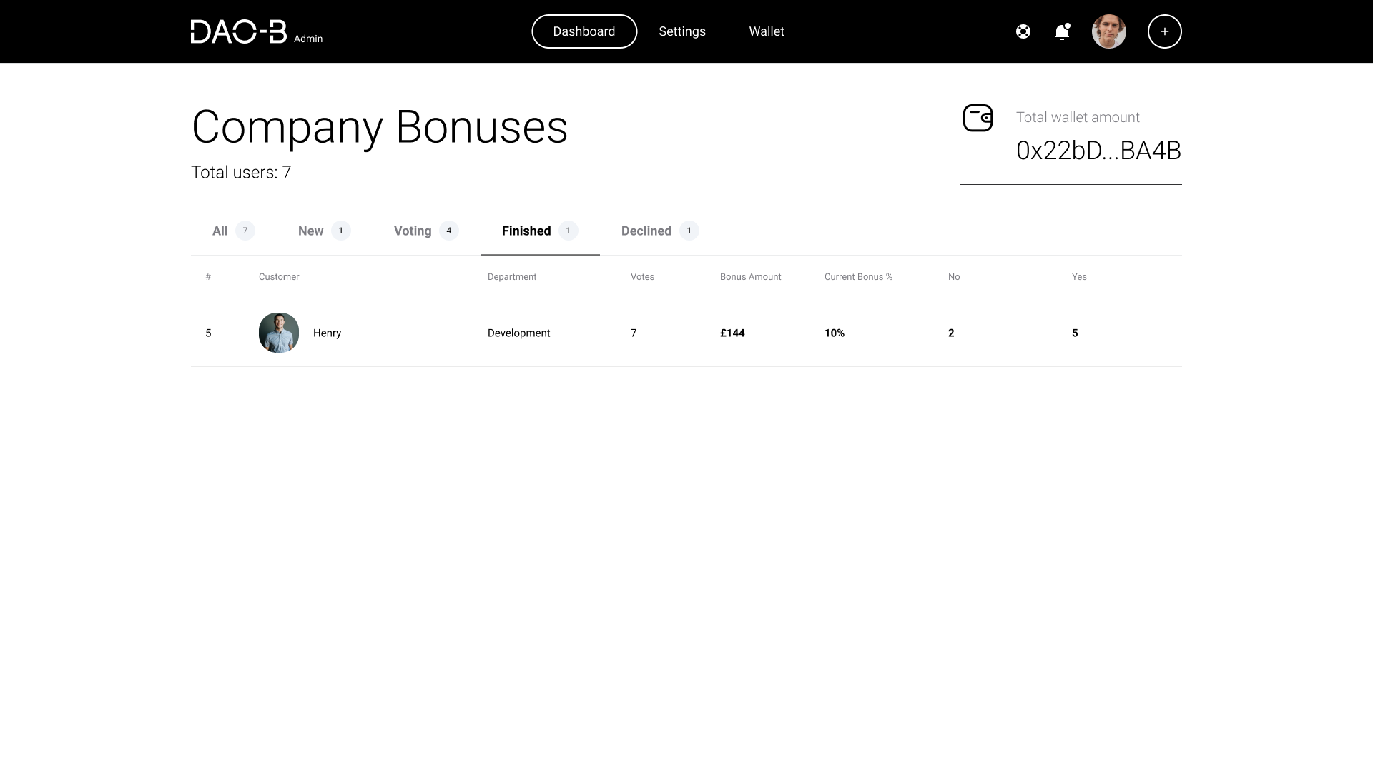

Slide 23
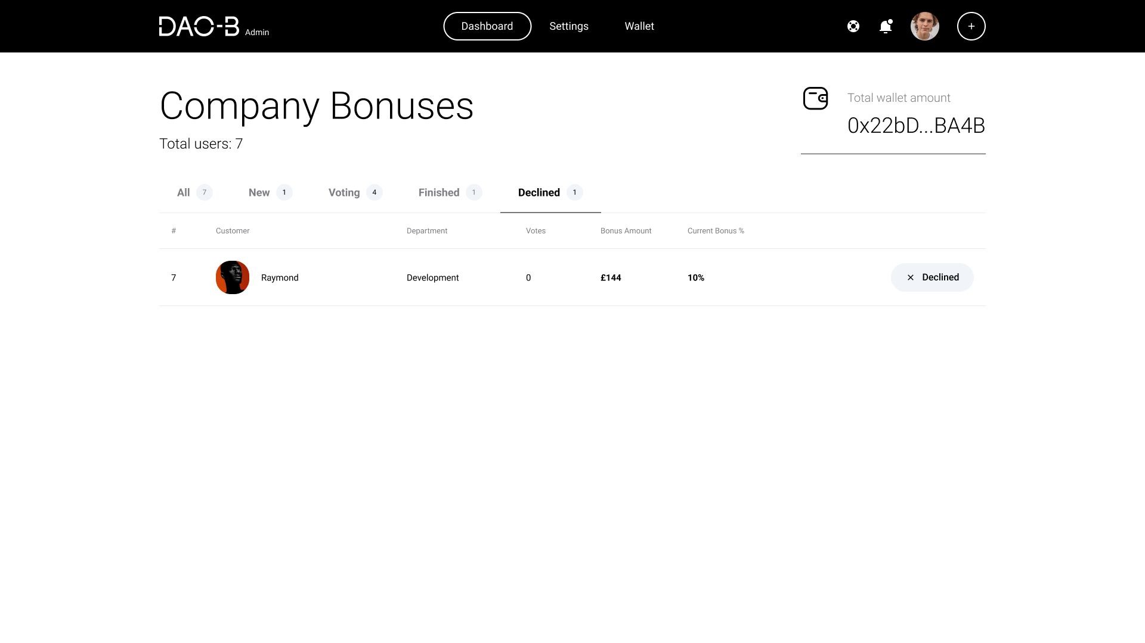

Slide 24
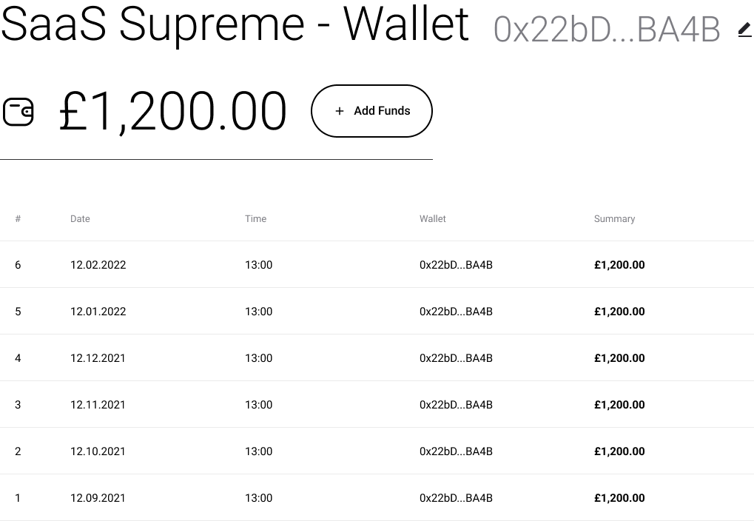
Autonomous Recurring Deposits
I have enabled deposits for the main wallet through DAO-B. These can be made recurring to line up with voting periods, aiding in the autonomy of the system. There is no need/capability to enable smart contracts for deposits as they are completely dependent on the business having funds available.

Slide 25
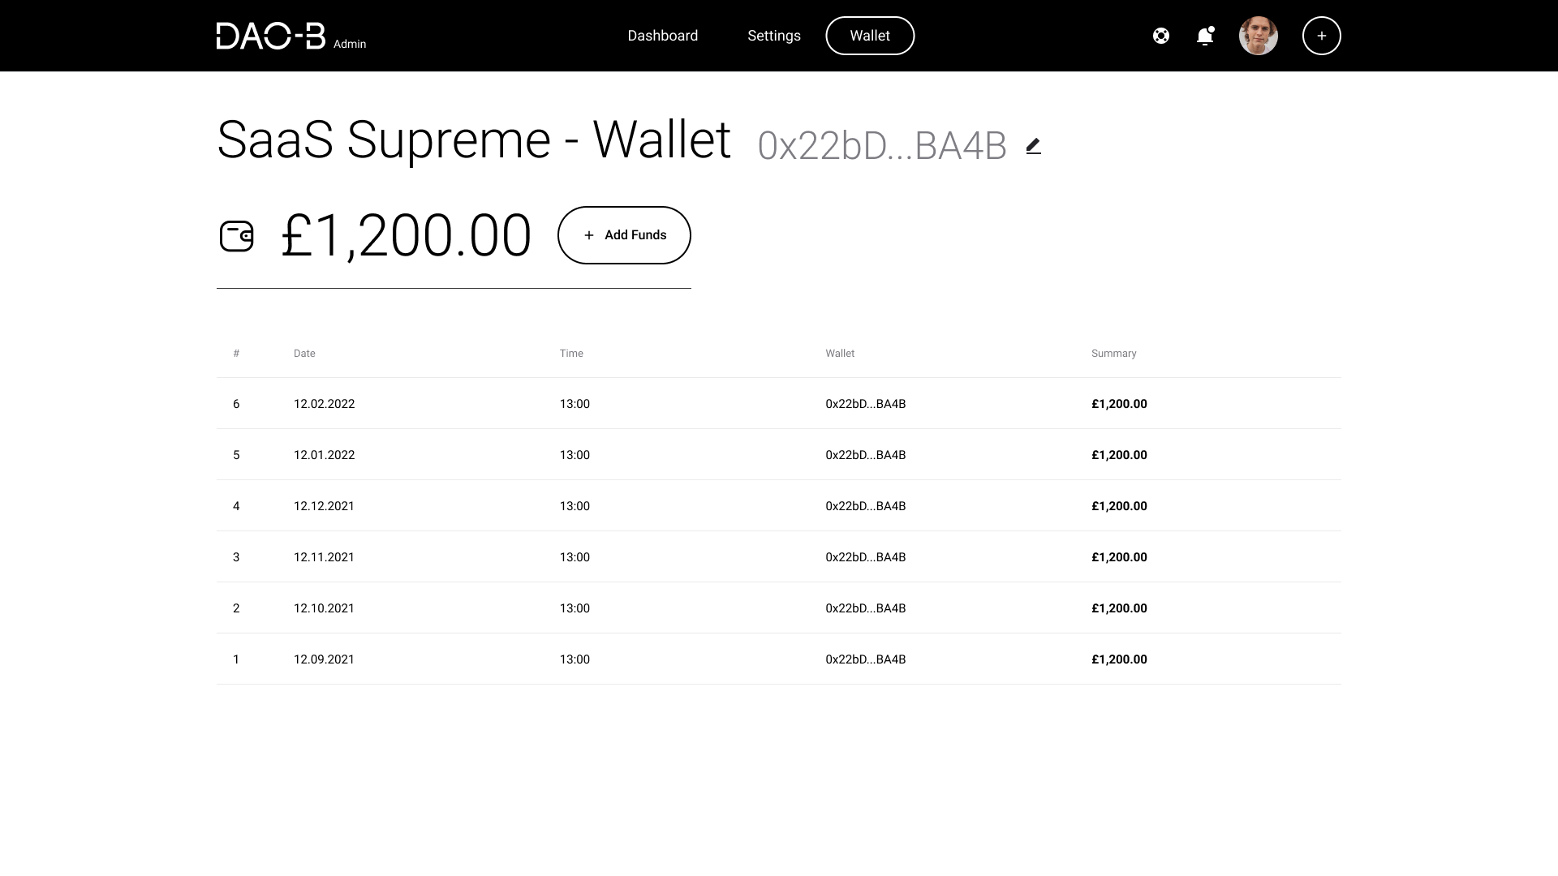

Slide 26
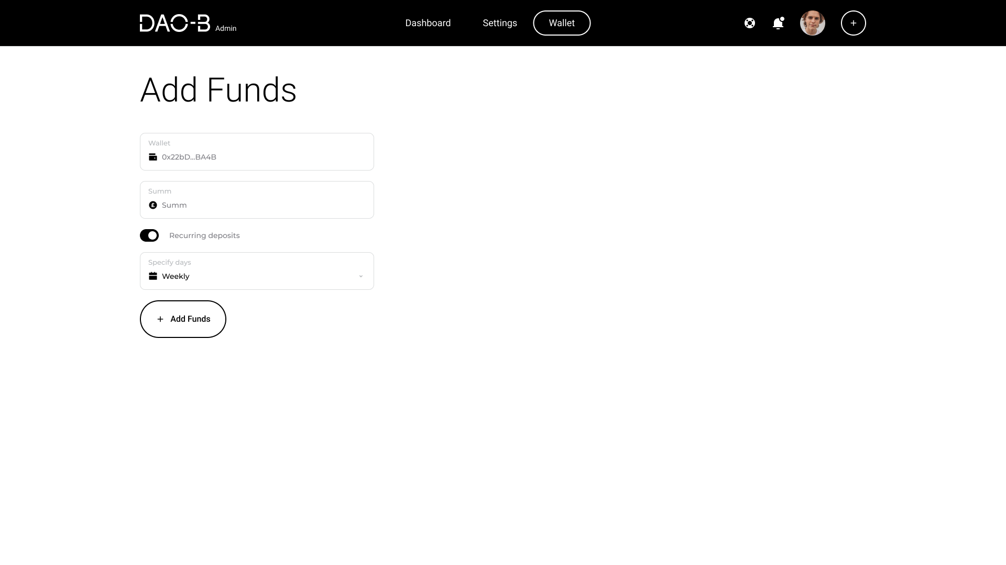

Slide 27
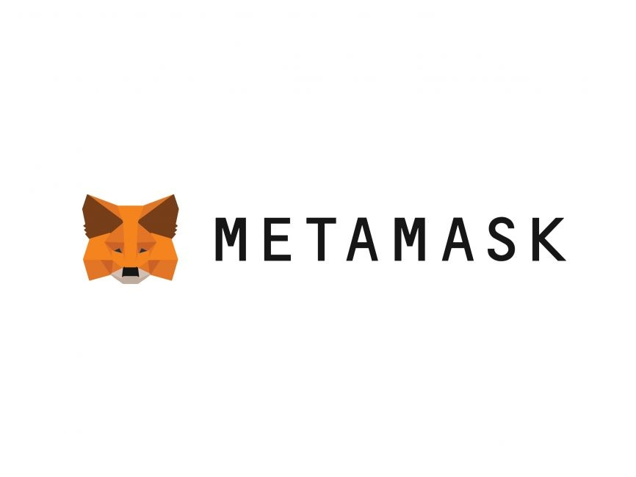
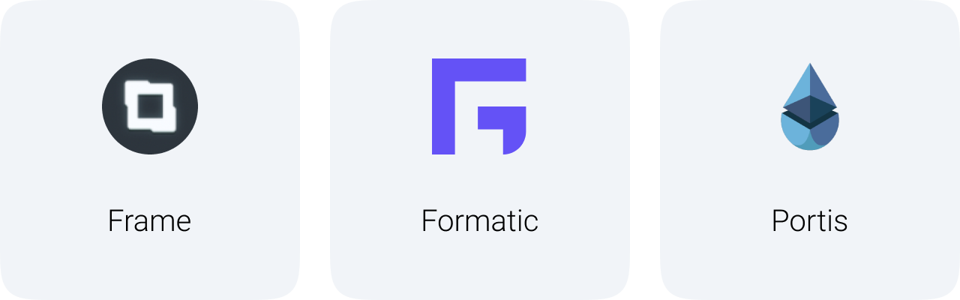
Wallet Integration
I have worked on enabling some of the more mainstream $ETH wallets, these will be linked for deposits or withdrawals in the DAO-B system.

Slide 28
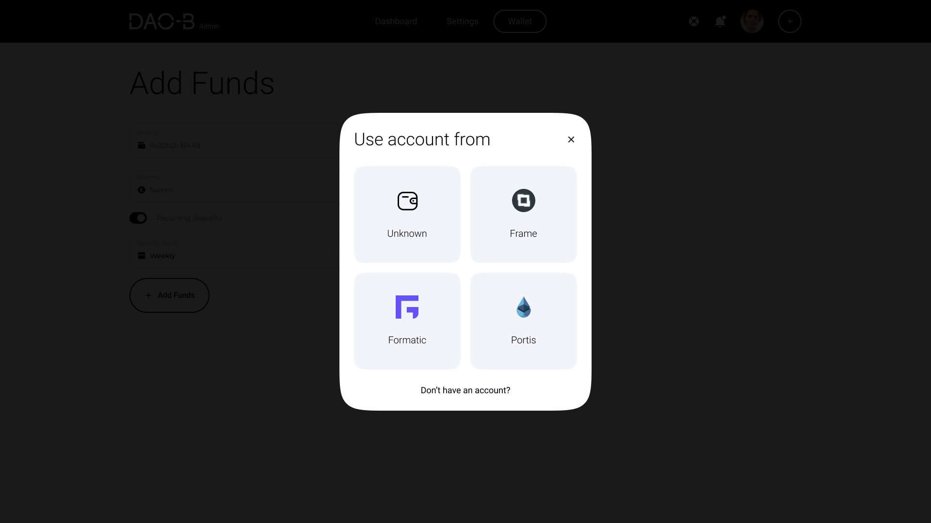
Unknown wallets can also function on the app just with less integration. All that is needed is the corresponding addresses for depositing/withdrawing.

Slide 29
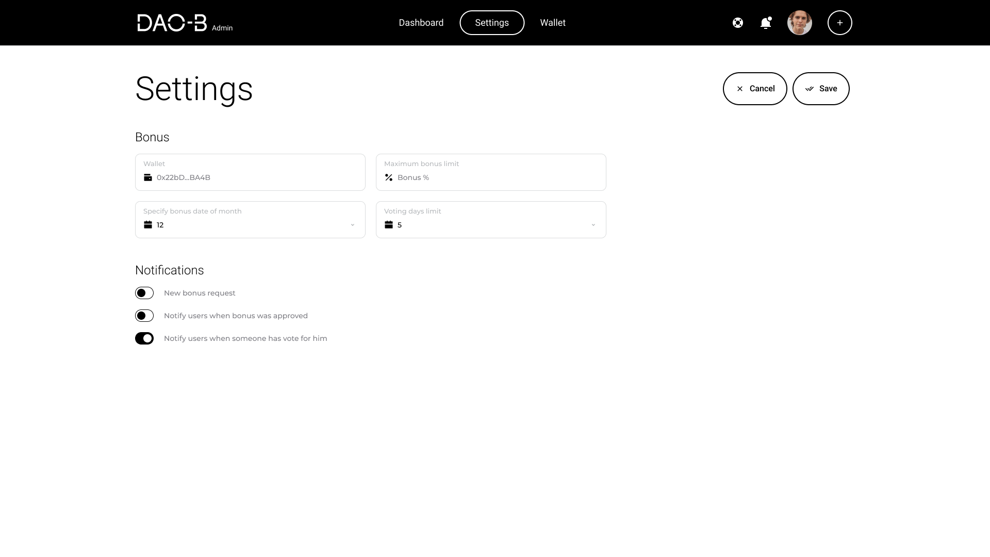

Slide 30
Admin has additional nav bar controls.
Wallet address input, also links to the previously shown integrations.
Notification management for both users and admins on the DAO-B system.
Again, another system to back up the sensible use of DAO-B is the maximum bonus limit, it can also be set by the admin.
Set the days for how long a vote should be held open, I haven’t decided which model is more appropriate yet, either every member has to vote before proposal is paid out or there is a cut-off time and whatever is majority vote gets paid out.

Slide 31

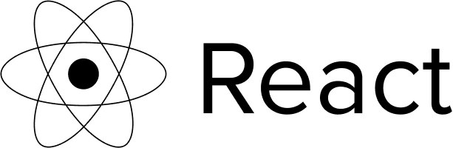
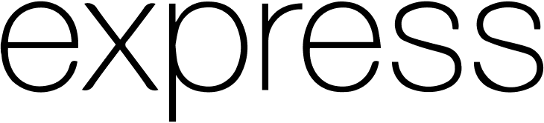
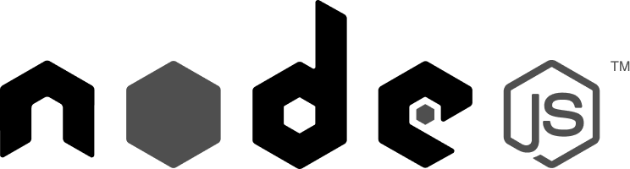
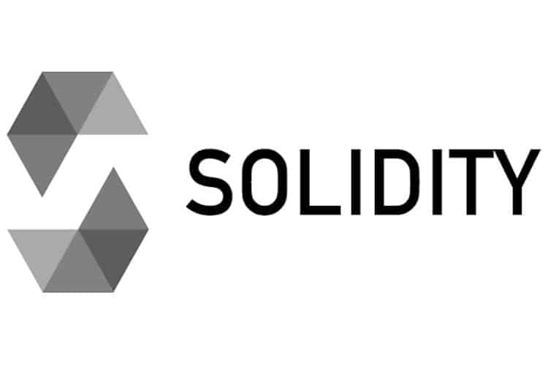
DAO-B Tech Stack - MERN
Schema-less scalability. simple data, larger organisations.
Provides routing components and supports middleware. Excellent HTML functionality.
Easy Debugging, simple view creation and integration
Lightweight, scalable, vast ecosystem
Metamask for wallet integration, simple integration and easy UI
Smart contract generation, using remix to deploy and test

