Slide 1
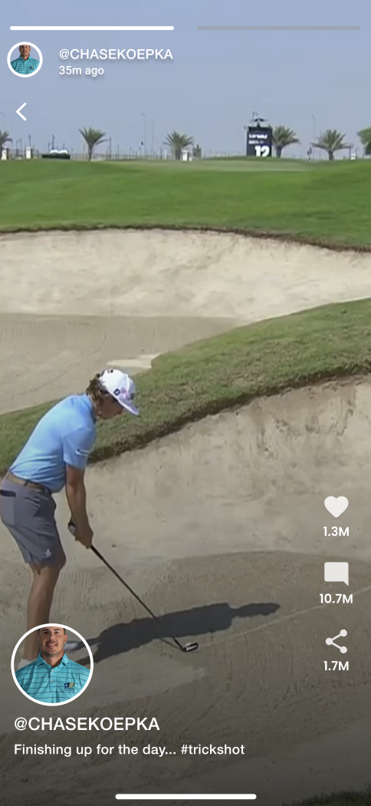
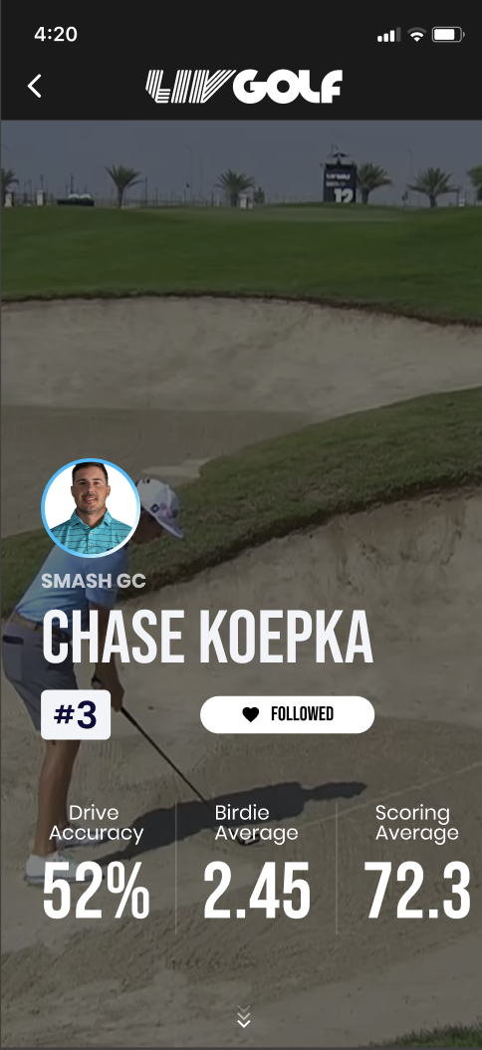

AGENCY CONCEPT / DIGITAL MATCHDAY
OWN THE
MATCHDAY.
One product to make a new team format legible, habit-forming and monetisable.
A proposition for league decision-makers
LIV GOLF

Slide 2
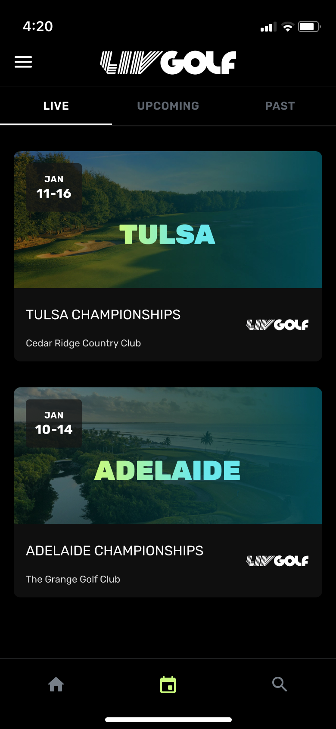
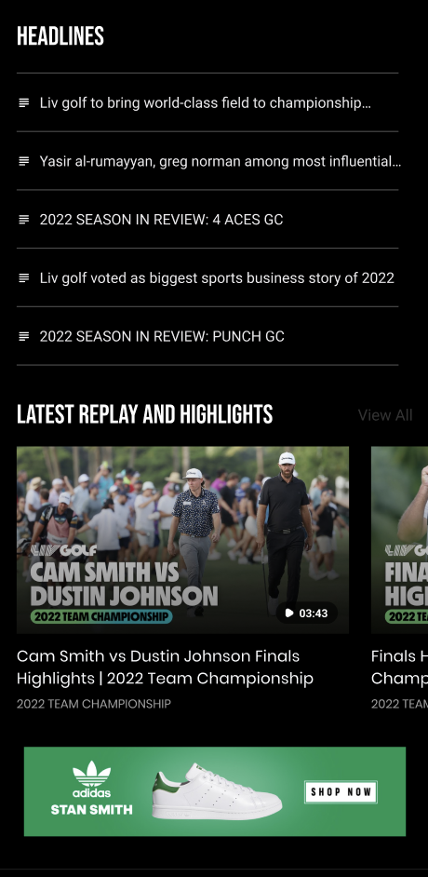
LIV GOLF / THE OPPORTUNITY
02
A NEW LEAGUE CANNOT
INHERIT A FAN HABIT.
The format has pace. The product must supply context, allegiance and a reason to return.
The job is bigger than digitising a leaderboard.
DISCOVER
→
UNDERSTAND
→
RETURN

Slide 3
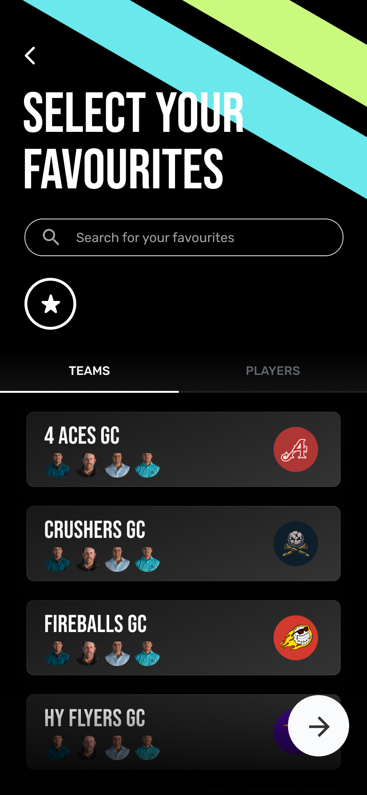
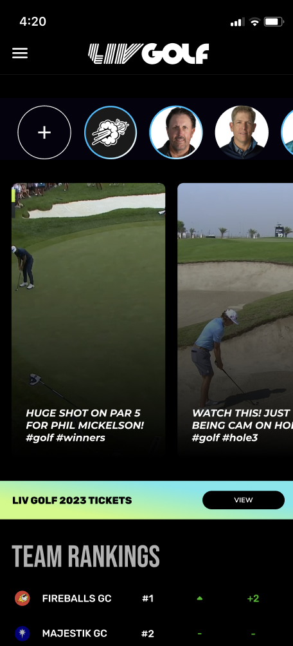
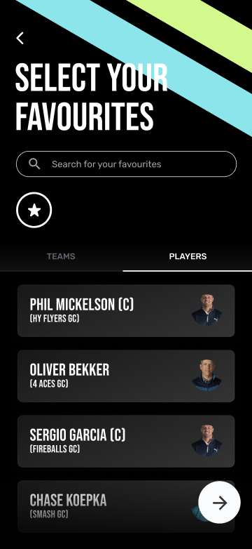
LIV GOLF / FAN JOBS
03
ONE FAN.
FOUR JOBS.
01
ORIENT ME FAST
Who is leading—and why?
02
GIVE ME A SIDE
A team and players worth backing.
03
SHOW WHAT CHANGED
Every swing in context, not isolation.
04
LET ME ACT
Watch, follow, buy or unlock now.
THE PRODUCT PROMISE: ONE GLANCE TO KNOW WHAT MATTERS.

Slide 4
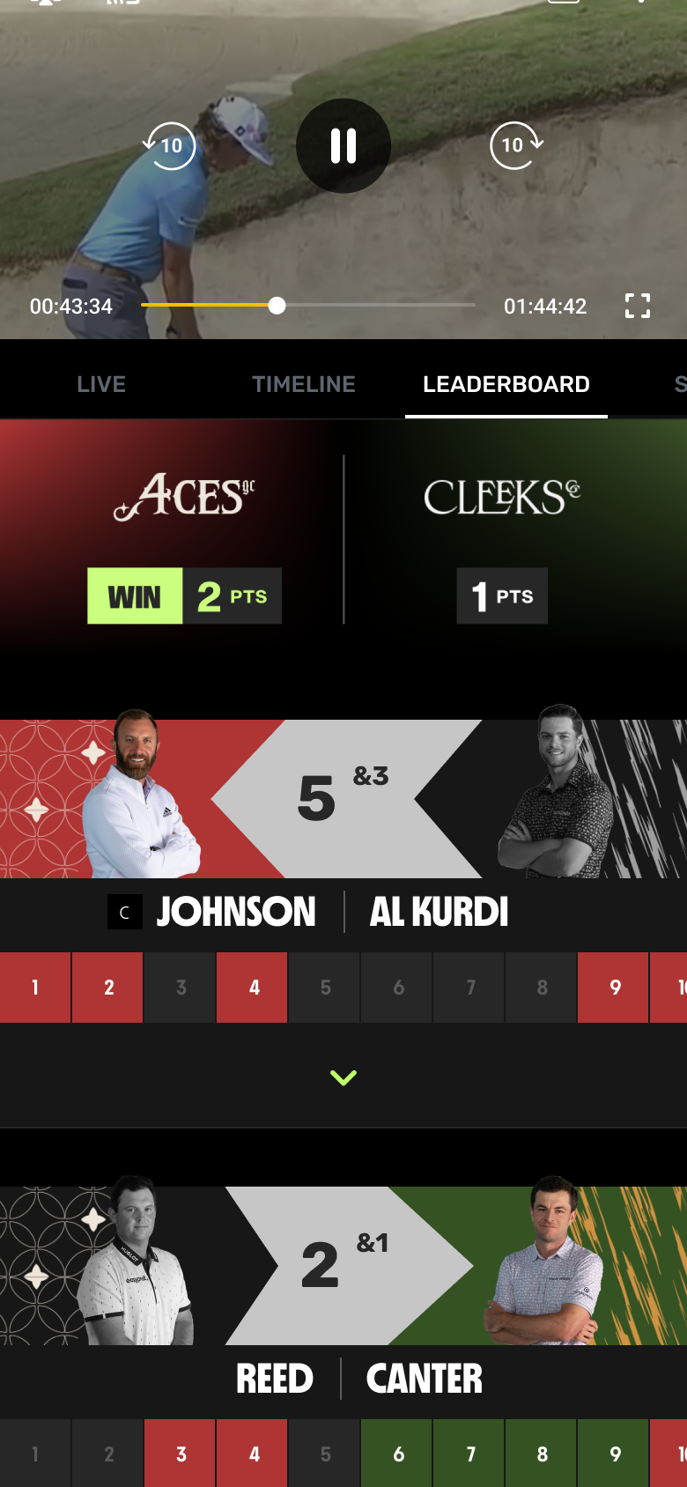
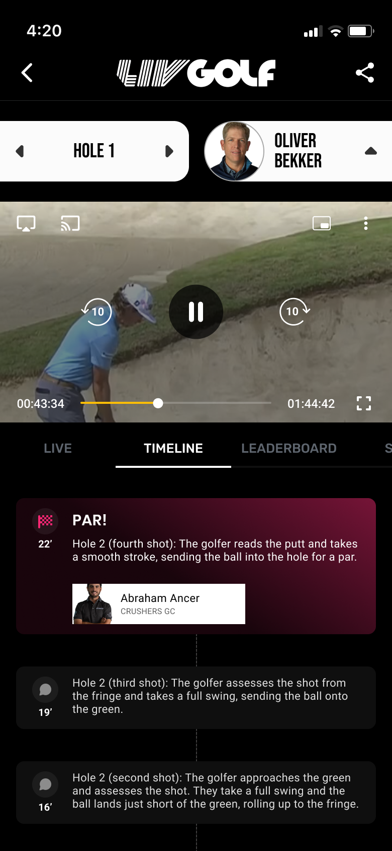
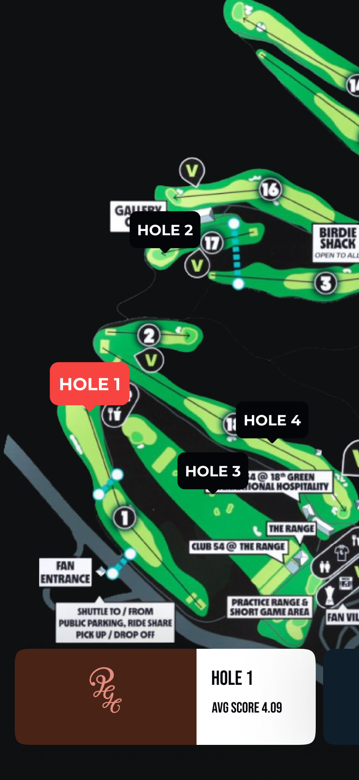
LIV GOLF / LIVE VIEWING SYSTEM
04
MAKE THE SHOTGUN START
READ LIKE A STORY.
Three synchronized views answer the live questions in order.
NOW
WHY
NEXT
What changed
What it means
Where action moves

Slide 5
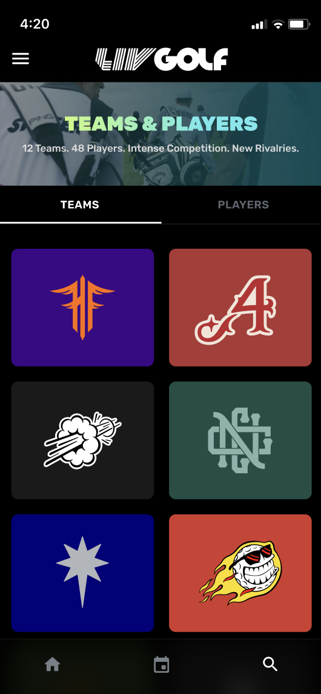
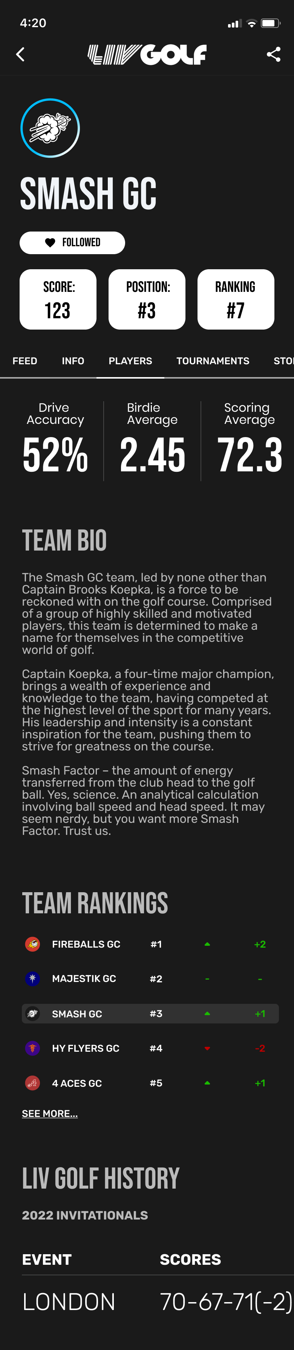
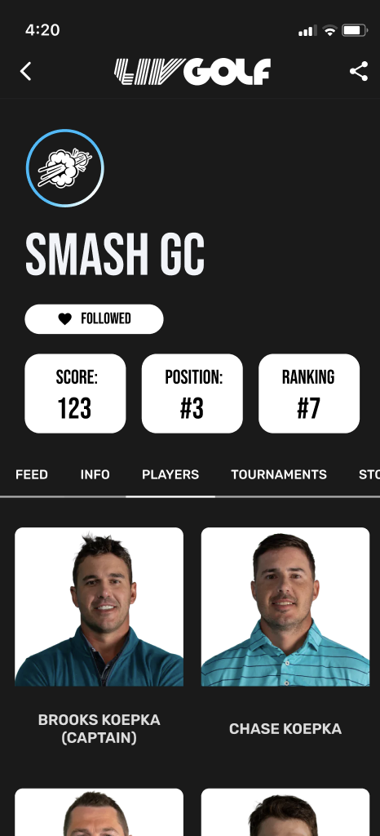
LIV GOLF / TEAM IDENTITY
05
TEAMS ARE THE
MEMORY SYSTEM.
Rosters change. Venues move. A team gives fans one stable thing to follow across the season.
SIGNATURE
A distinct visual world.
SQUAD
People and chemistry.
SEASON
A record that compounds.
SIGNATURE
SQUAD
DEPTH

Slide 6
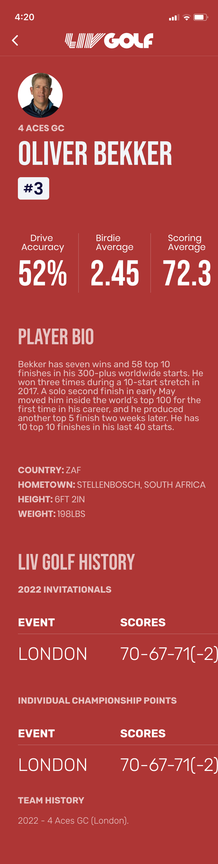
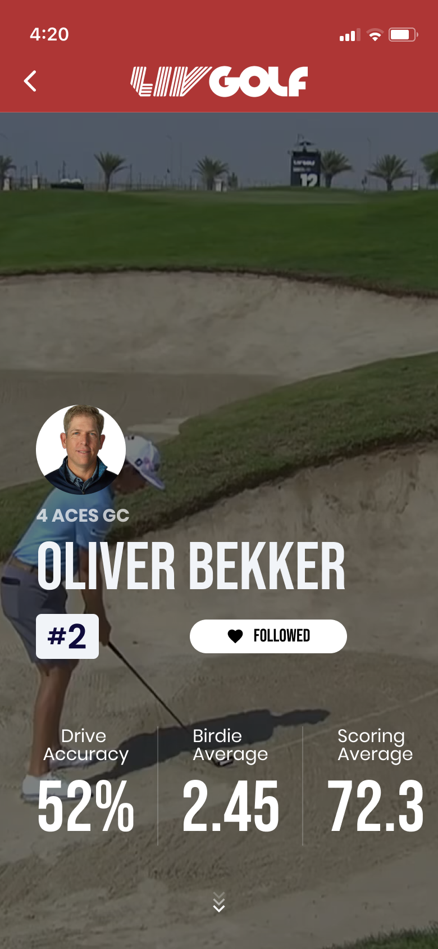
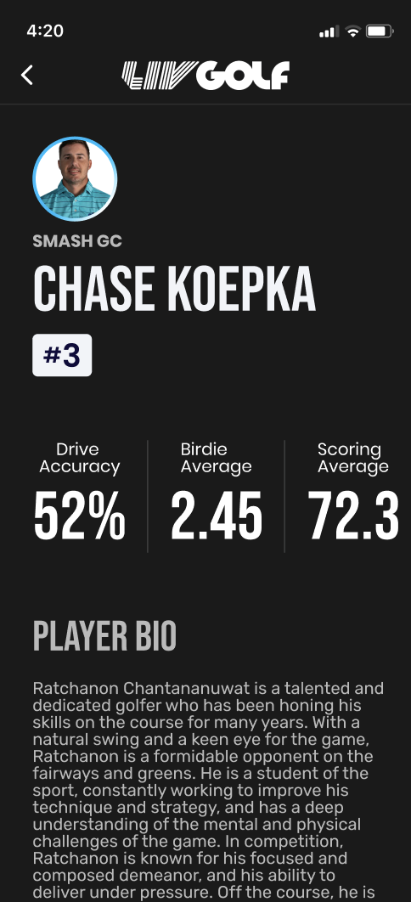
LIV GOLF / PERSONALISATION
06
PERSONALISATION
TURNS NOISE
INTO RIVALRY.
Choose a team. Follow two players. See the match through that lens.
YOUR DEFAULT MATCHDAY
Your team / your players / your live implications
FEEL
FOLLOW
KNOW

Slide 7
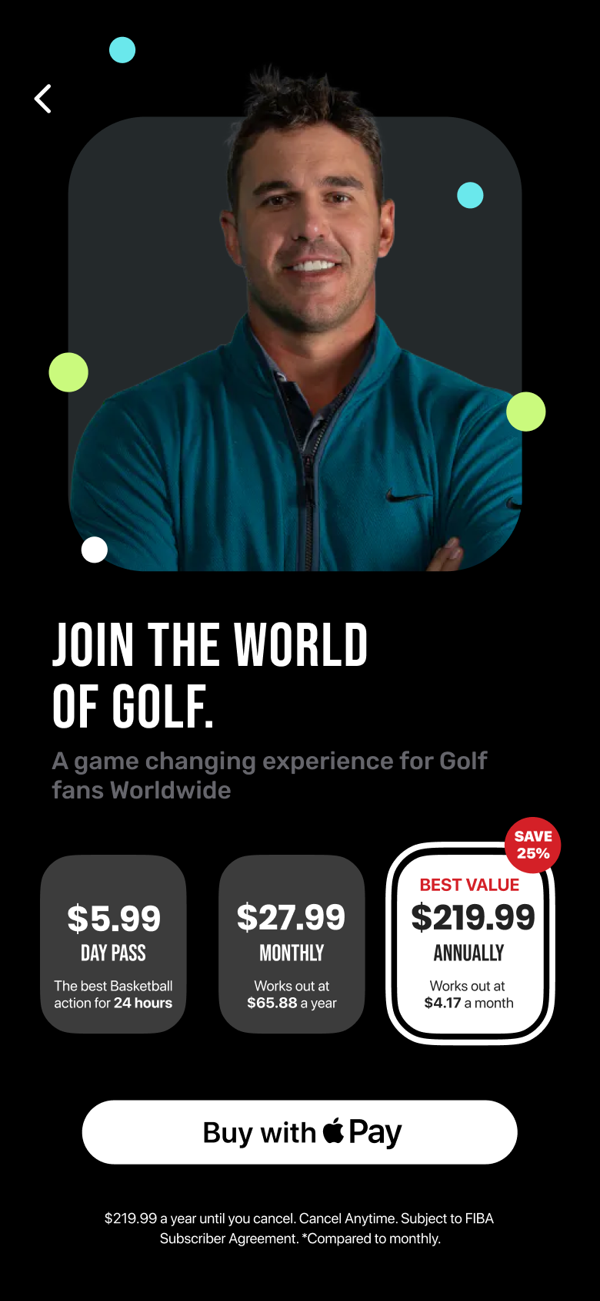
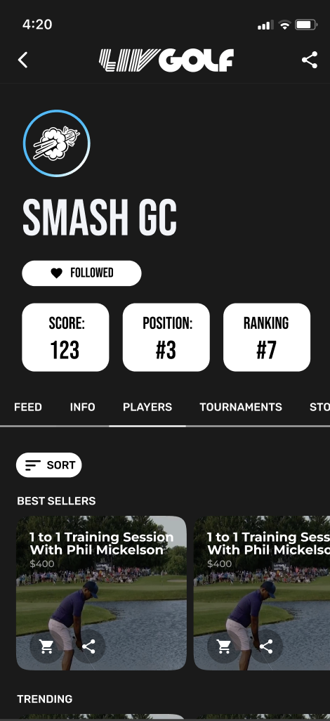
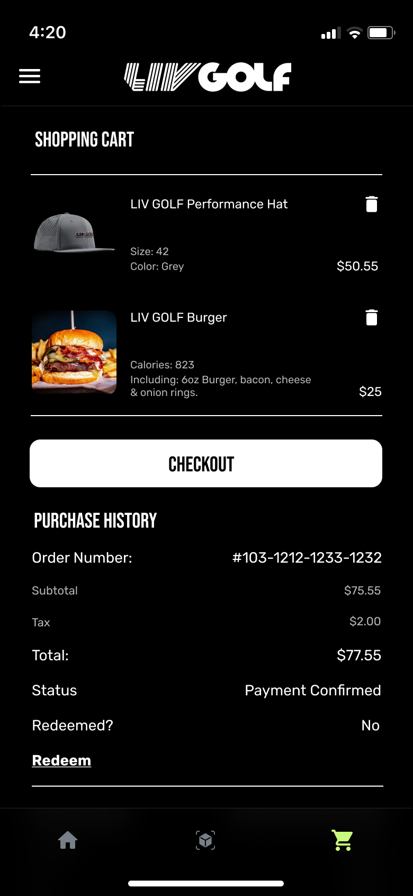
LIV GOLF / COMMERCIAL LOOP
07
MONETISE THE MOMENT
WITHOUT BREAKING IT.
Every transaction should feel like the next natural fan action.
ACCESS
BELONG
COLLECT
Event pass or season membership
Team drops and player experiences
One checkout, saved intent

Slide 8
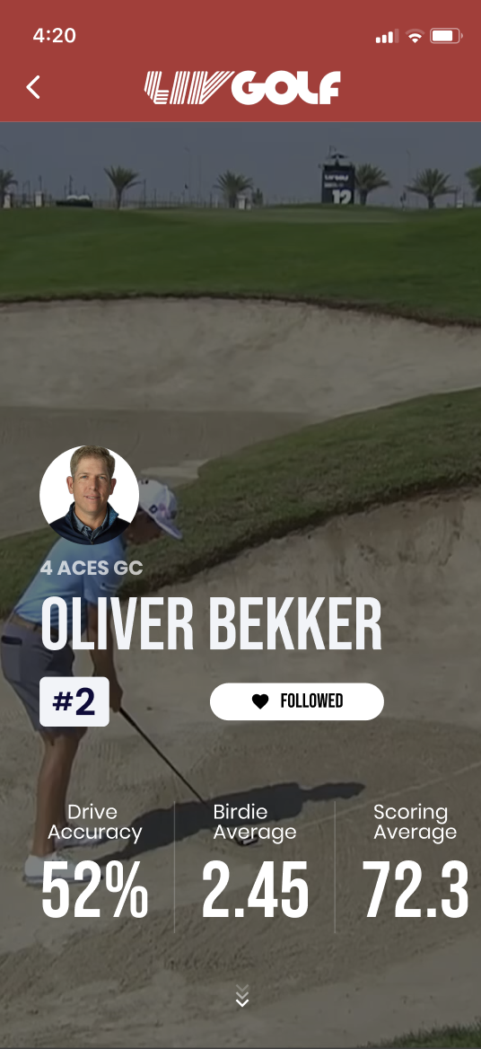
LIV GOLF / ILLUSTRATIVE COMMERCIAL MODEL
08
FREQUENCY MAKES
THE MODEL WORK.
Three revenue pools grow from the same known-fan base.
£1.0m
DIRECT ACCESS
1.0m eligible viewers × 12% registered × 20% buying × £42 annual digital spend
£2.6m
TEAM COMMERCE GMV
40k annual orders × £65 average order value
£1.5m
MATCHDAY SPONSOR
INVENTORY
THE PRINCIPLE
6 integrated packages × £250k
Monetise repeated attention—not a one-off download.
Illustrative concept model — not a forecast.

Slide 9
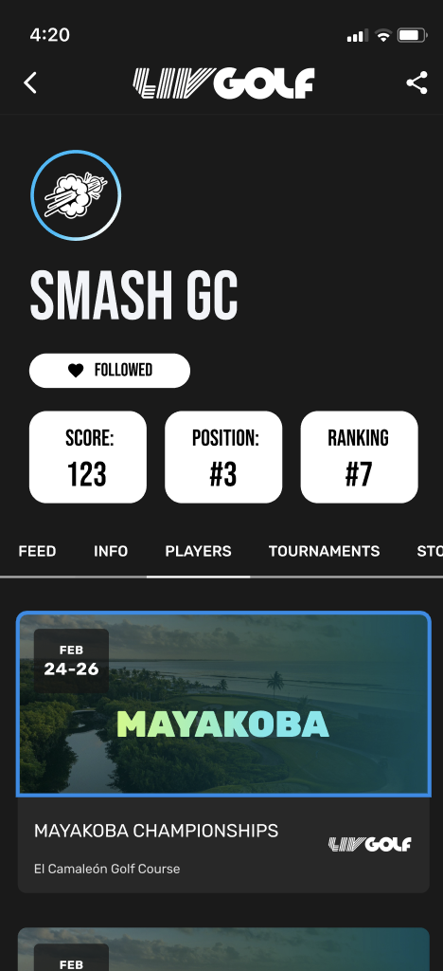
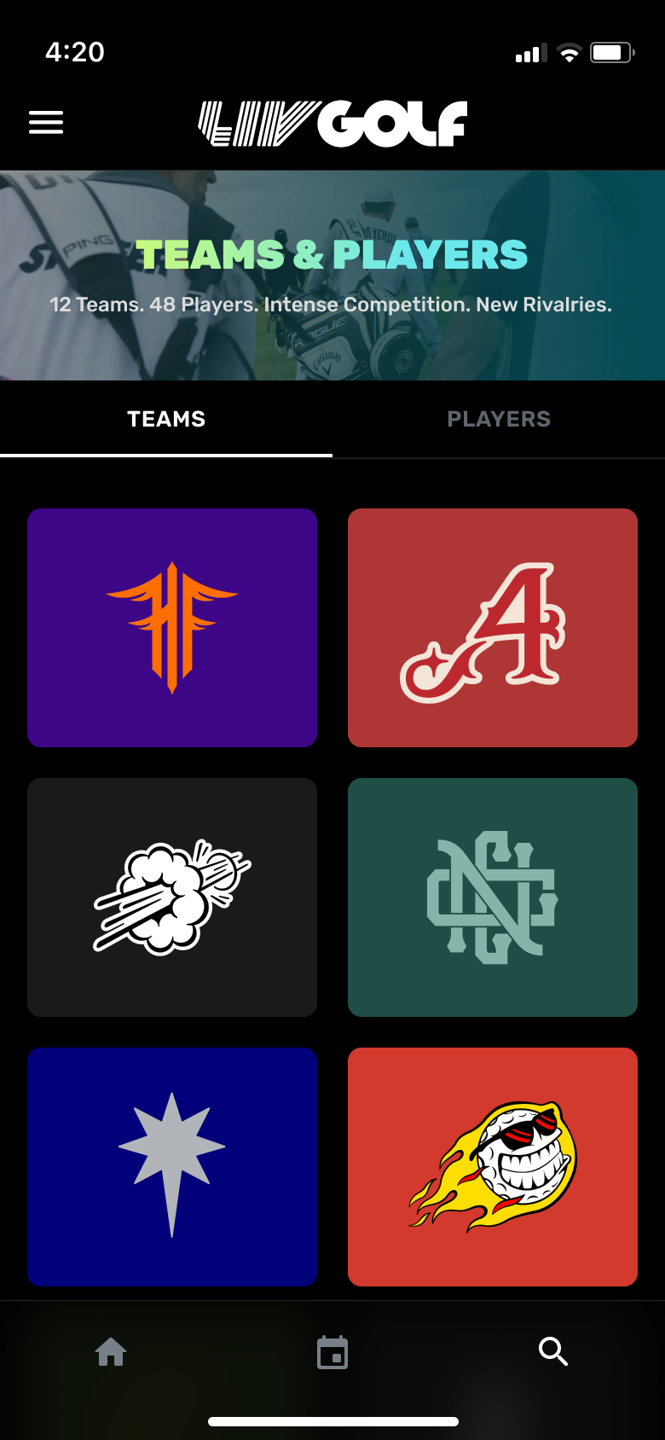
LIV GOLF / PROPOSED PILOT
09
LAUNCH THREE EVENTS.
PROVE THREE BEHAVIOURS.
One decision gate after the third event.
01
02
03
CLARITY
HABIT
VALUE
Can fans explain who leads and why?
Do fans choose a team or player lens?
Will engaged fans take a paid action?
≥70% task success
≥30% follow rate
≥8% action rate
PROPOSED SUCCESS GATES
Validate targets against prototype and live-event analytics.
Illustrative concept model — not a forecast.

Slide 10
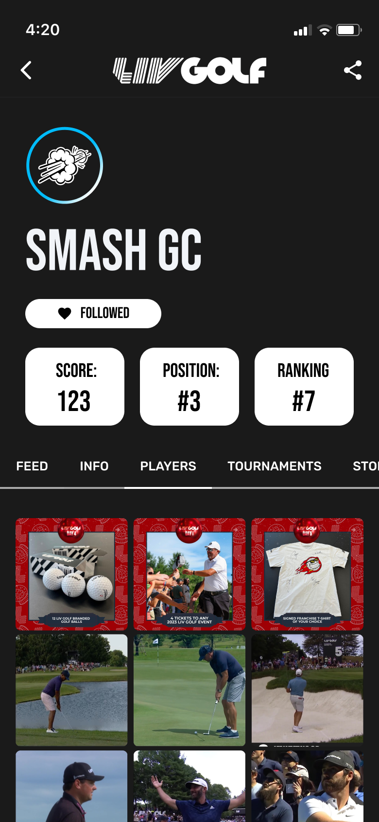
LIV GOLF / THE DECISION
10
DECISION
WHAT WE SHIP
OWN THE
MATCHDAY.
LIVE
Matchday hub: timeline, board and map
FOLLOW
Team and player personalisation layer
Approve one three-event pilot of a product that unifies live understanding, identity and commerce.
ACT
Access, store and unified checkout
LEARN
Clarity, habit and value measurement
ONE PRODUCT. ONE PILOT. ONE DECISION GATE.
GO / THREE-EVENT PILOT
If clarity, habit and value move together, scale the platform.
AGENCY CONCEPT / FOR DISCUSSION

