Slide 1
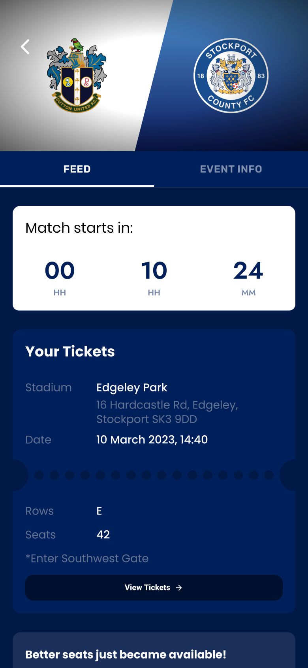
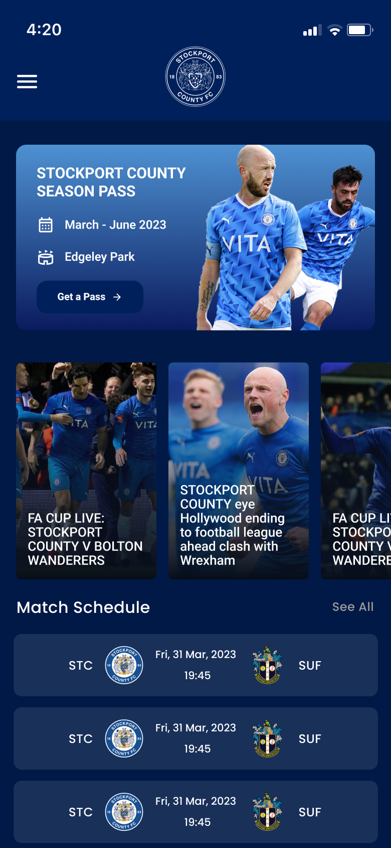
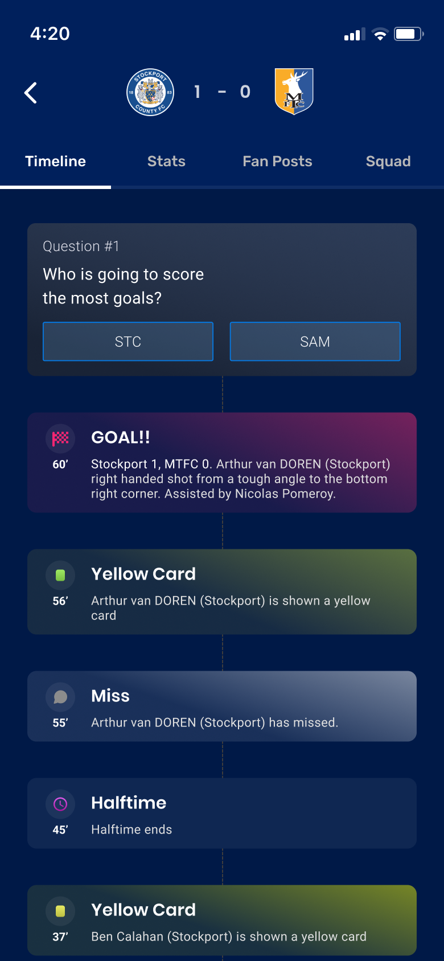
FOOTBALL SMART-STADIUM PROPOSAL
CONNECTED
MATCHDAY
Make matchday one connected experience.
An illustrative agency pitch for a mobile companion spanning planning, entry, live context, stadium services, loyalty, and the next visit.
PRE-MATCH
LIVE
ILLUSTRATED WITH STOCKPORT COUNTY REFERENCE IMAGERY
HOME
No affiliation or endorsement implied
Independent agency concept · illustrative content and assumptions · no affiliation or endorsement implied
01 / 10
Notes:
Slide 1: Make matchday one connected experience. Independent agency concept; all interface data and assumptions are illustrative.

Slide 2
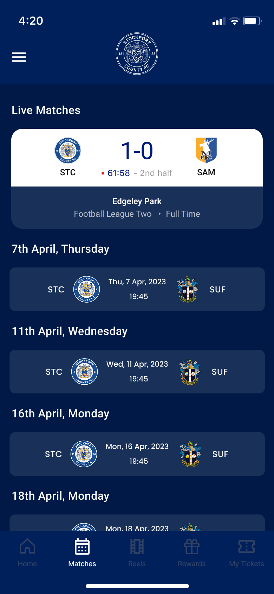
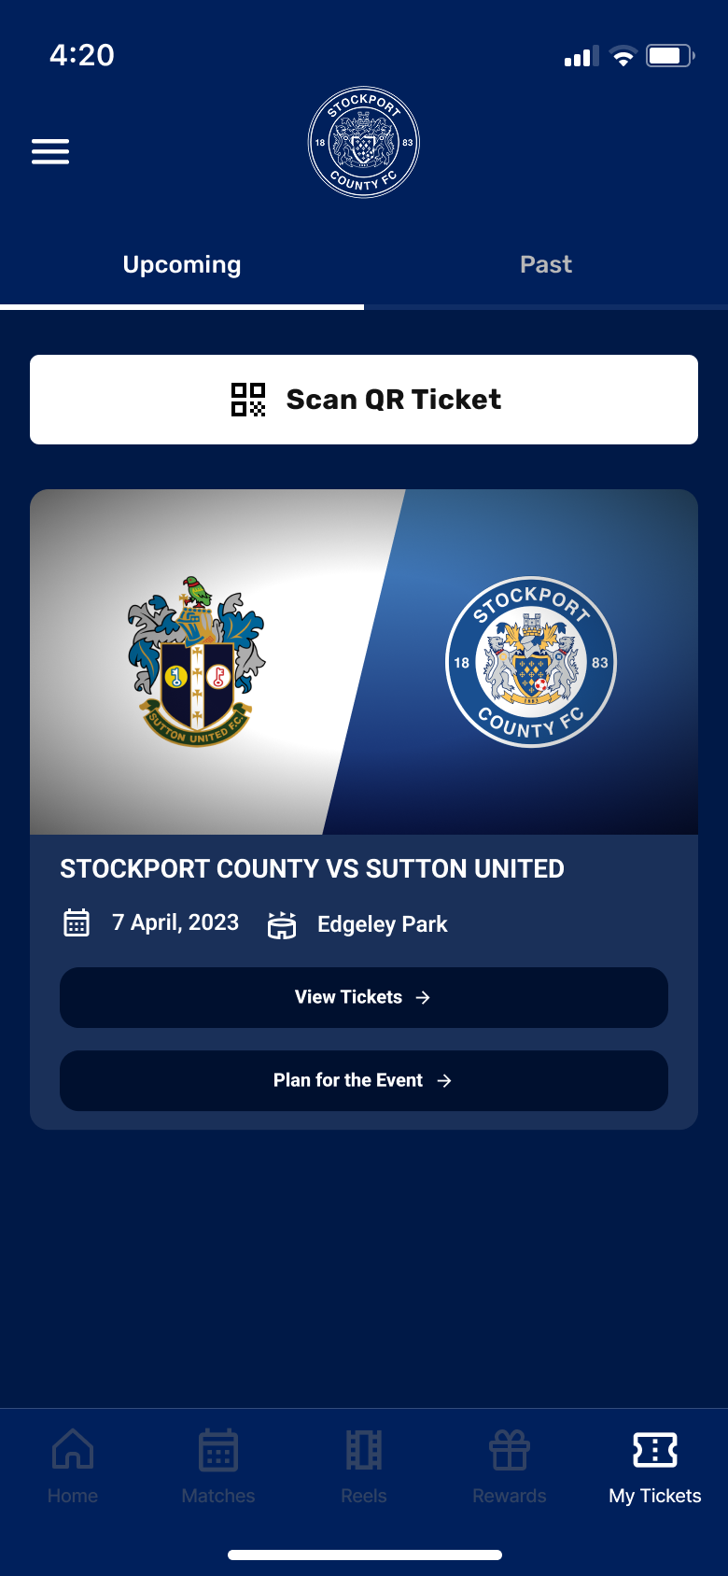
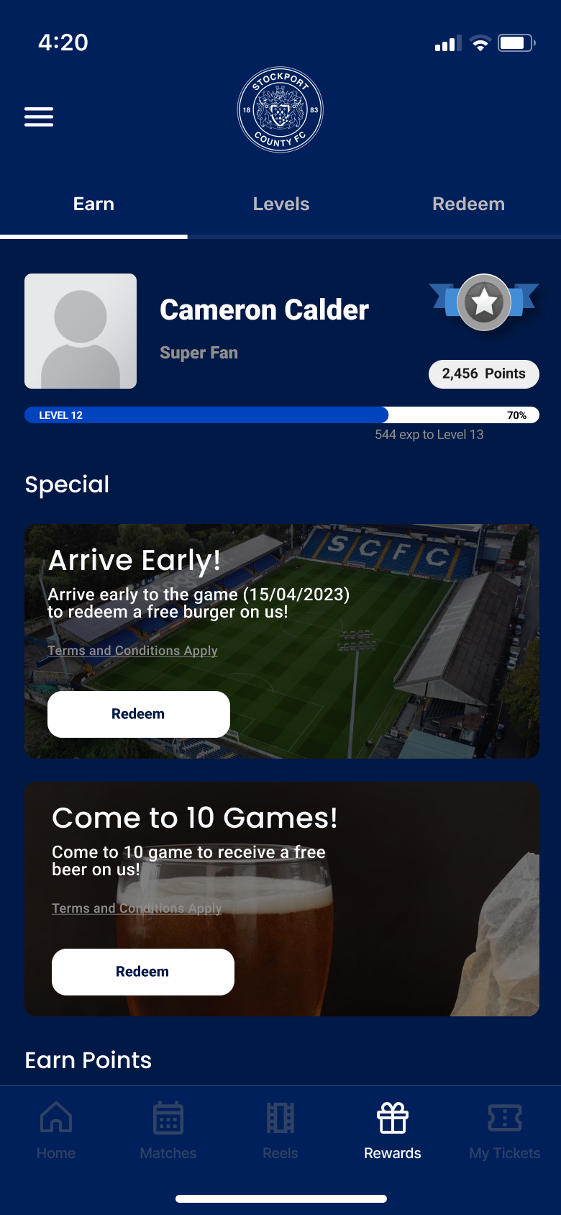
INDEPENDENT AGENCY CONCEPT
THE OPPORTUNITY
The opportunity is to carry supporter context across every hand-off.
Opportunity hypothesis: separate journeys make supporters repeatedly recover context, identity, and intent.
01
02
03
04
05
DISCOVER
PLAN
ENTER
EXPERIENCE
RETURN
Fixtures and club content
Tickets and seat choice
Access and verification
Live context and services
Rewards and next fixture
THE PRODUCT OPPORTUNITY
Carry the same supporter context through every matchday state.
Concept screens
One identity · one event timeline · one next-best action
Independent agency concept · illustrative content and assumptions · no affiliation or endorsement implied
02 / 10
Notes:
Slide 2: The opportunity is to carry supporter context across every hand-off. Independent agency concept; all interface data and assumptions are illustrative.

Slide 3
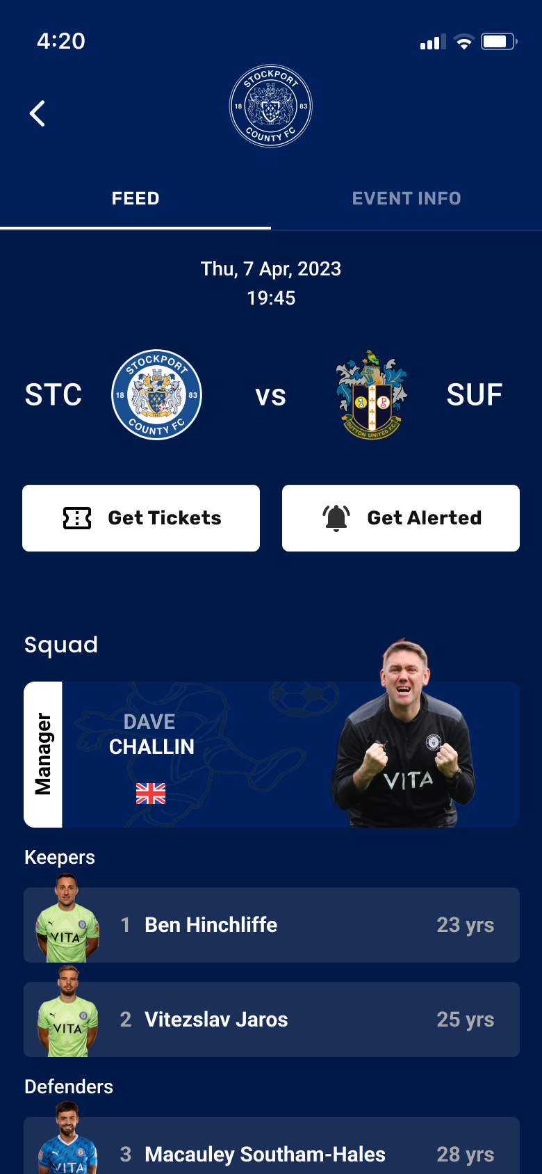
INDEPENDENT AGENCY CONCEPT
THE PRODUCT SPINE
The product should change with the match clock.
One event space can change what it foregrounds before kick-off, during play, and after full time.
ARRIVE READY
FOLLOW THE MOMENT
PLAN WHAT COMES NEXT
Ticket, timing, wayfinding, and optional upgrades.
Key events, match state, and optional depth in one place.
The next fixture carries the relationship beyond full time.
01
02
03
PRE-MATCH
LIVE
POST-MATCH
A single event identity carries context across the clock.
Independent agency concept · illustrative content and assumptions · no affiliation or endorsement implied
03 / 10
Notes:
Slide 3: The product should change with the match clock. Independent agency concept; all interface data and assumptions are illustrative.

Slide 4
INDEPENDENT AGENCY CONCEPT
DISCOVERY AND PLANNING
One home gets supporters to the next useful action.
The concept uses a stable home structure, then brings forward the most useful matchday action.
1
ONE GLANCE
Next fixture, latest content, tickets, and store entry points share one hierarchy.
2
ONE STATE
The selected match becomes the context for alerts, ticket actions, and squad information.
3
ONE NEXT ACTION
What is useful now can lead without hiding the wider club destination.
FIXTURES
Illustrative product hierarchy — not a researched information architecture
HOME
FIXTURE
Independent agency concept · illustrative content and assumptions · no affiliation or endorsement implied
04 / 10
Notes:
Slide 4: One home gets supporters to the next useful action. Independent agency concept; all interface data and assumptions are illustrative.

Slide 5
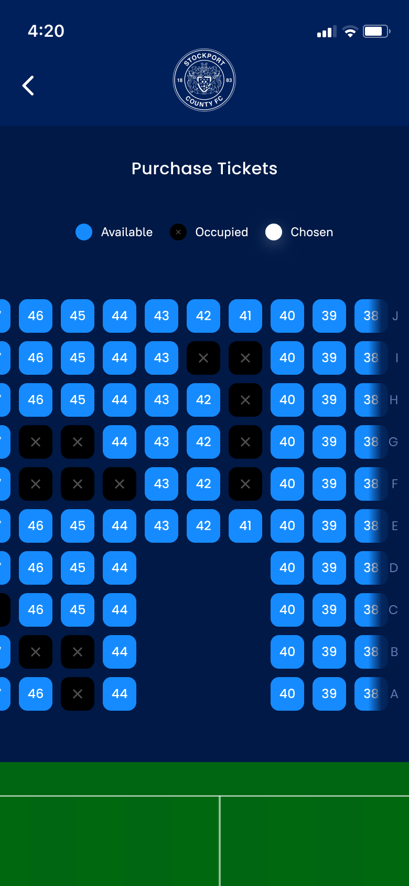
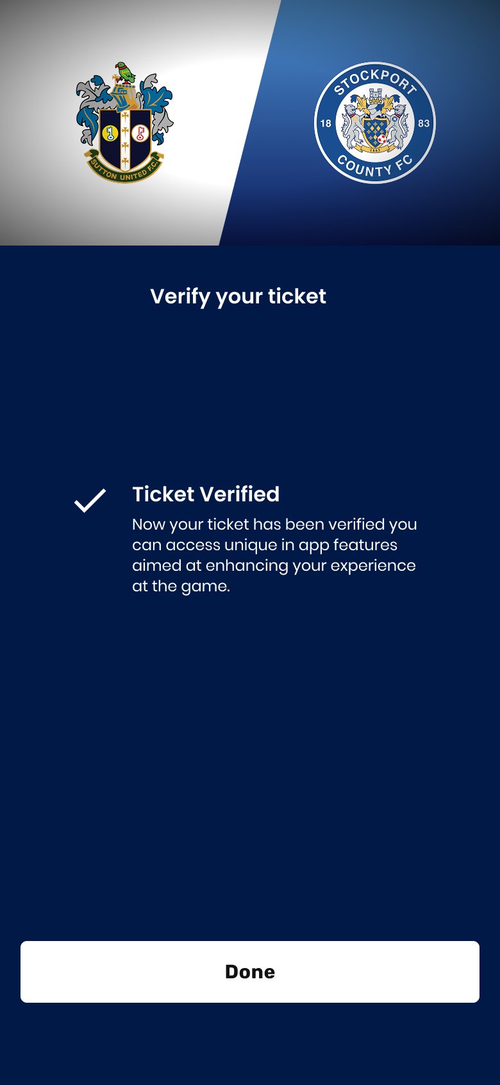
INDEPENDENT AGENCY CONCEPT
ACCESS AND ENTRY
A ticket should unlock more than a seat.
The proposal links ticket discovery, seat choice, and verified access to the same matchday identity.
Upcoming ticket
Seat selection
Verified matchday
Bring the next match into view.
Make choice visible and reversible.
Carry access into the event experience.
FIND
CHOOSE
UNLOCK
PROPOSAL PRINCIPLE
A verified ticket becomes the key to relevant services — not proof that these flows were deployed.
Independent agency concept · illustrative content and assumptions · no affiliation or endorsement implied
05 / 10
Notes:
Slide 5: A ticket should unlock more than a seat. Independent agency concept; all interface data and assumptions are illustrative.

Slide 6
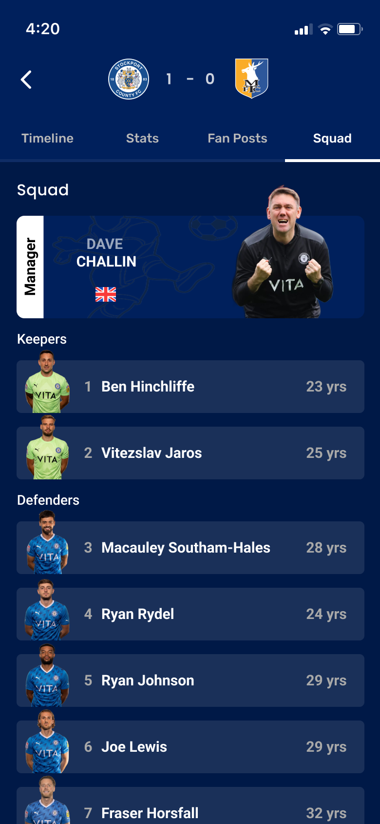
INDEPENDENT AGENCY CONCEPT
THE LIVE MOMENT
Live context should add to the game — not compete with it.
Live information earns its place by answering one immediate question, then getting out of the way.
1
WHAT CHANGED?
A readable event timeline keeps goals, cards, and key moments together.
2
WHAT IS HAPPENING?
A focused match state keeps the live result and wider fixture context legible.
3
WHO IS INVOLVED?
A structured squad view adds depth without crowding the event state.
MATCH STATE
TIMELINE
SQUAD
Concept rule: utility first, optional depth second.
Independent agency concept · illustrative content and assumptions · no affiliation or endorsement implied
06 / 10
Notes:
Slide 6: Live context should add to the game — not compete with it. Independent agency concept; all interface data and assumptions are illustrative.

Slide 7
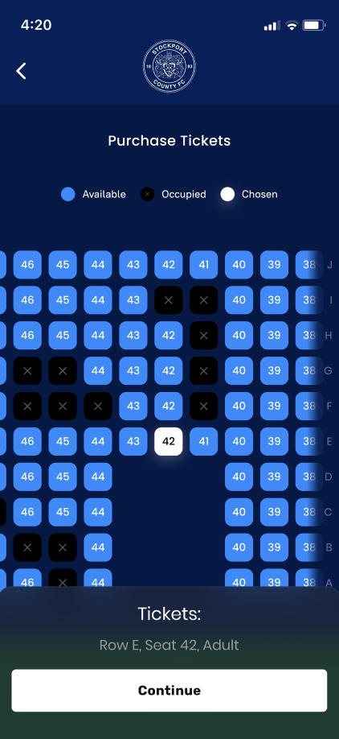
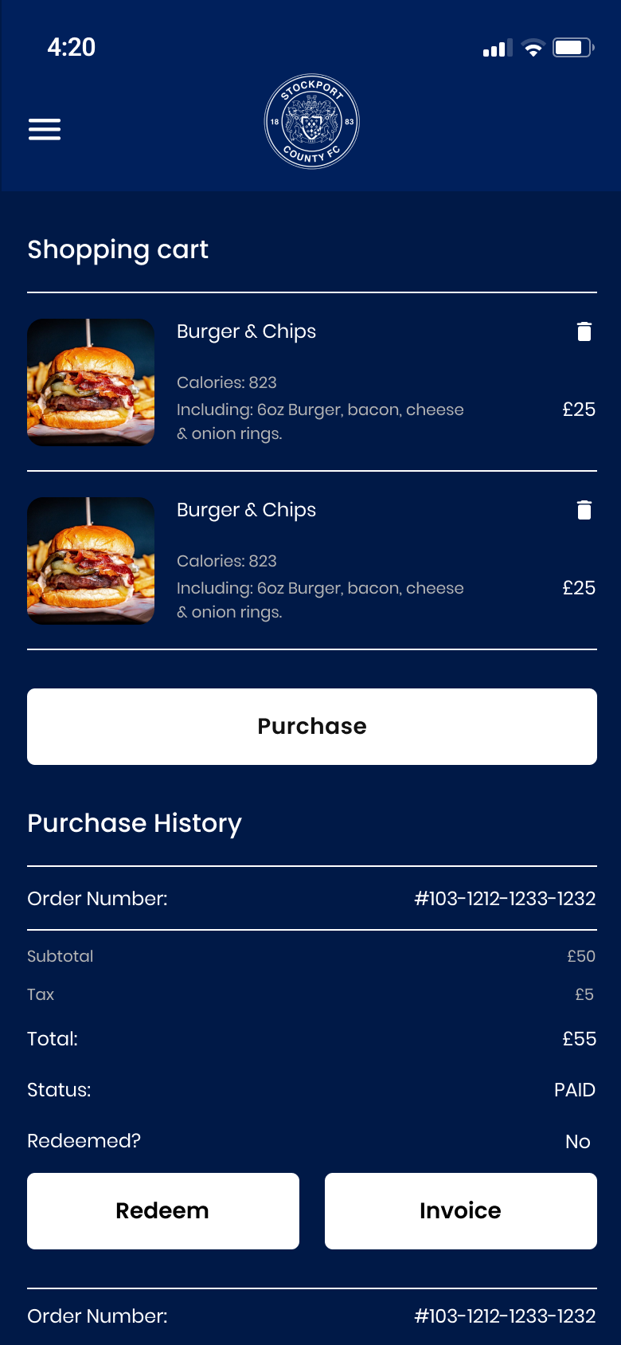
INDEPENDENT AGENCY CONCEPT
SMART-STADIUM SERVICES
Stadium services should feel like part of the match.
Useful services can arrive in the event context, while checkout and receipts remain clear and accountable.
1
CONTEXT
Match, time, ticket, and location establish what may be useful.
2
SERVICE
Seat upgrades, support, and other matchday services appear as optional actions.
3
CONTROL
Basket, payment state, redemption, and receipt keep the transaction explicit.
BEFORE
UPGRADE
RECEIPT
All prices, orders, and commercial mechanics are illustrative sample content.
Independent agency concept · illustrative content and assumptions · no affiliation or endorsement implied
07 / 10
Notes:
Slide 7: Stadium services should feel like part of the match. Independent agency concept; all interface data and assumptions are illustrative.

Slide 8
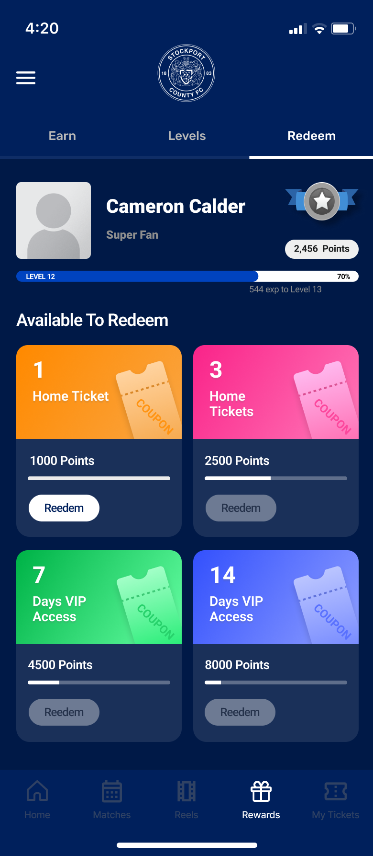
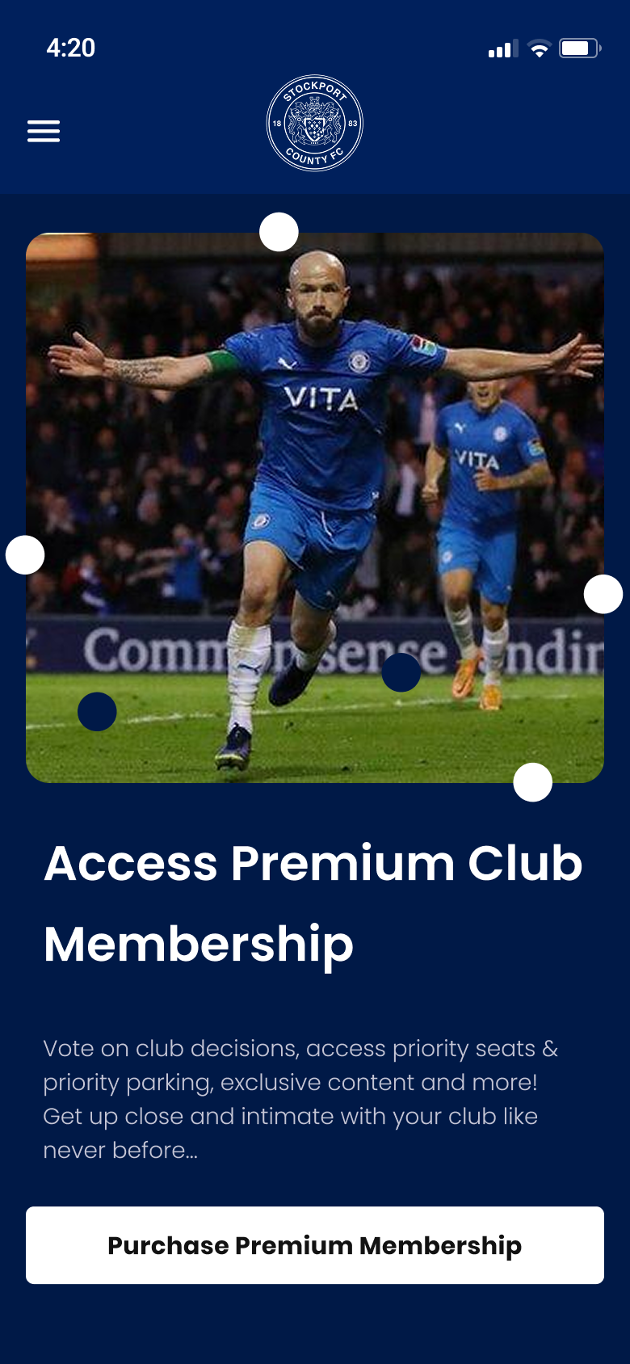
INDEPENDENT AGENCY CONCEPT
RELATIONSHIP AND RETURN
Every visit can compound into value and belonging.
The pitch connects attendance, participation, recognition, and the next visit around one supporter identity.
ATTEND
ONE
SUPPORTER
IDENTITY
RETURN
PARTICIPATE
EARN
EARN
REDEEM
MEMBERSHIP
ILLUSTRATIVE HYPOTHESES
No adoption, reward-liability, membership, or revenue outcome is claimed.
Independent agency concept · illustrative content and assumptions · no affiliation or endorsement implied
08 / 10
Notes:
Slide 8: Every visit can compound into value and belonging. Independent agency concept; all interface data and assumptions are illustrative.

Slide 9
INDEPENDENT AGENCY CONCEPT
PROPOSED PILOT
Three home matches can test access, engagement, and action.
DECISION GATES — NOT FORECASTS
Proposed pilot structure: validate the journey and operational fit before any platform commitment.
MATCH 01
MATCH 02
MATCH 03
ACCESS
ENGAGEMENT
ACTION
Prototype discovery, ticket choice, and verified entry with stadium operations.
Test event-state content, live context, and optional supporter participation.
Test service placement, transaction clarity, and the return-to-next-match loop.
Gate: journey is clear and operationally feasible.
Gate: context helps without distracting from the game.
Gate: actions are useful, trusted, and supportable.
Independent agency concept · illustrative content and assumptions · no affiliation or endorsement implied
09 / 10
Notes:
Slide 9: Three home matches can test access, engagement, and action. Independent agency concept; all interface data and assumptions are illustrative.

Slide 10
PROPOSED NEXT DECISION
Approve one club. One stadium. Three matches.
A focused pilot can turn the visual proposition into evidence without committing to a platform rebuild.
01
ONE OWNER
A club-side product lead able to align football, ticketing, venue, and commercial teams.
02
ONE EVENT PATH
Access to the systems and operations behind one representative home match.
ACCESS
HOME
FIXTURE
03
ONE PILOT WINDOW
Three proposed matches with explicit go, learn, and stop decisions.
DECISION: APPROVE A TIME-BOXED THREE-HOME-MATCH PILOT
Independent agency concept · illustrative content and assumptions · no affiliation or endorsement implied
10 / 10
Notes:
Slide 10: Approve one club. One stadium. Three matches. Independent agency concept; all interface data and assumptions are illustrative.

